Slide 1

Machine Learning
Dr. Abbas Malekpour

Slide 2

Type of Variables

Slide 3
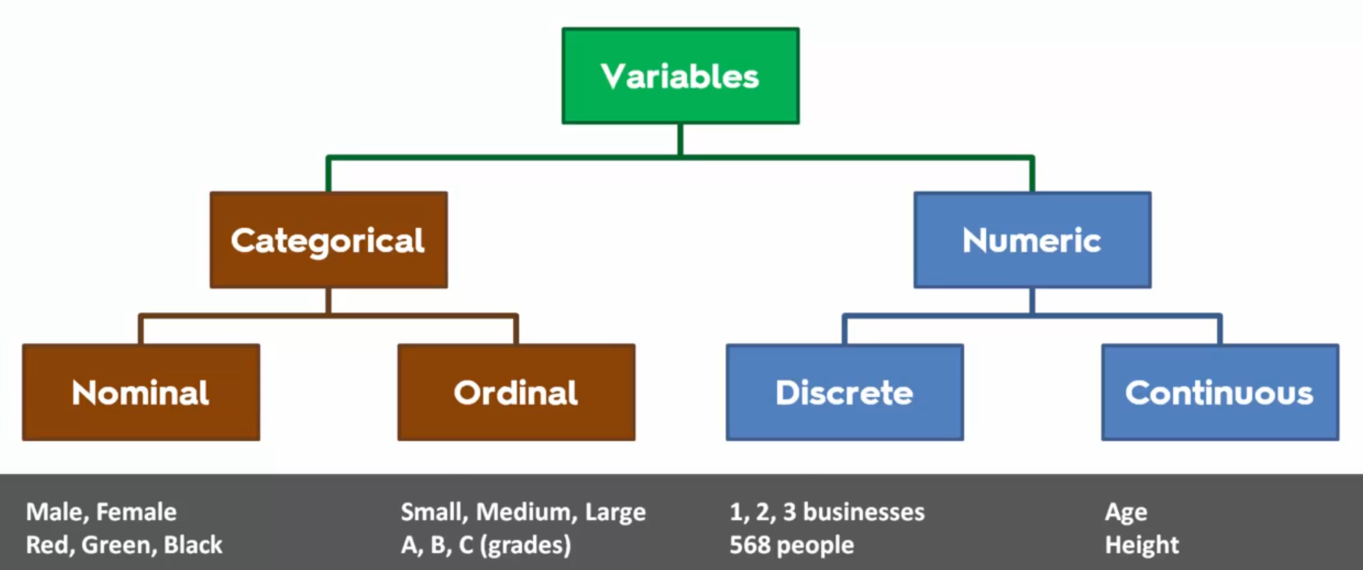
Type of Variables
Numerical and Categorical
Notes:
Target variable is Dependent Variable
All other features or variables are Independent variables

Slide 4
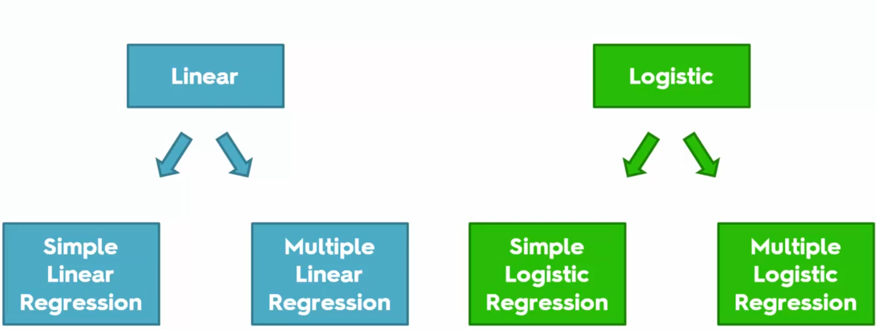
Regressions
Linear vs Logistic

Slide 6
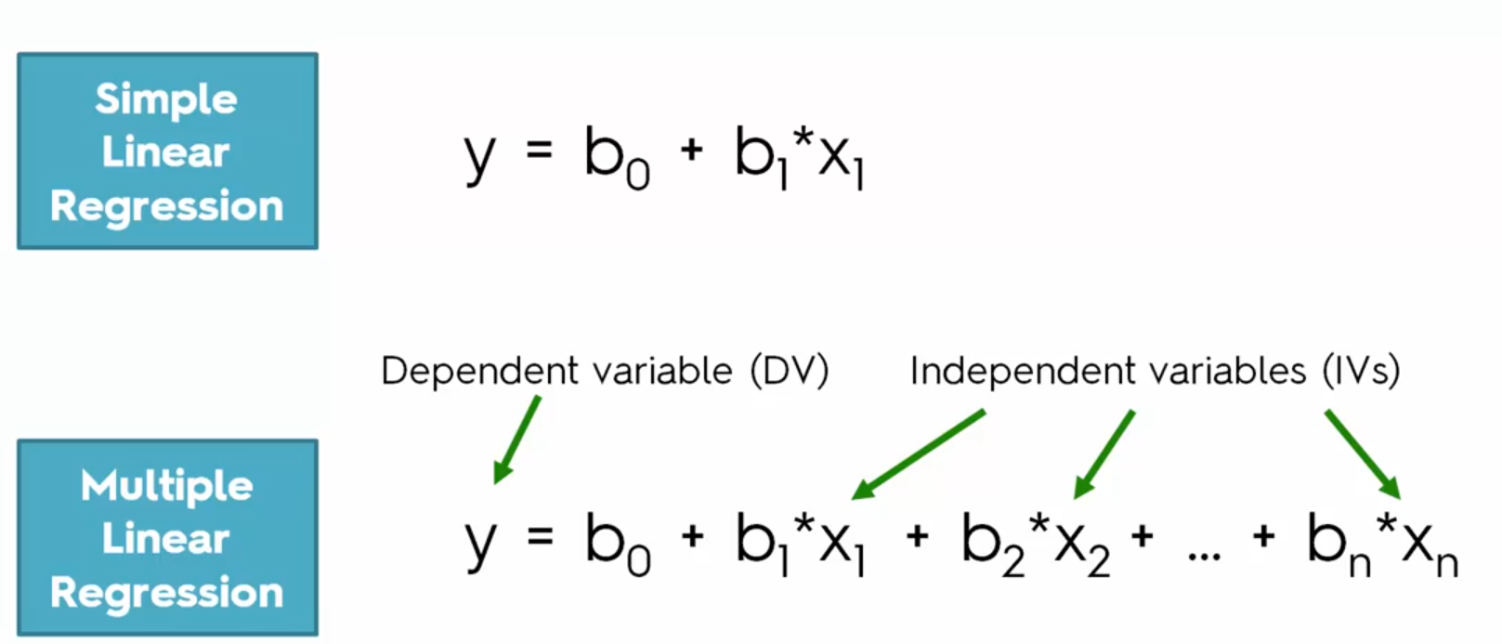
Equations
Simple vs Multiple Linear Regression

Slide 7
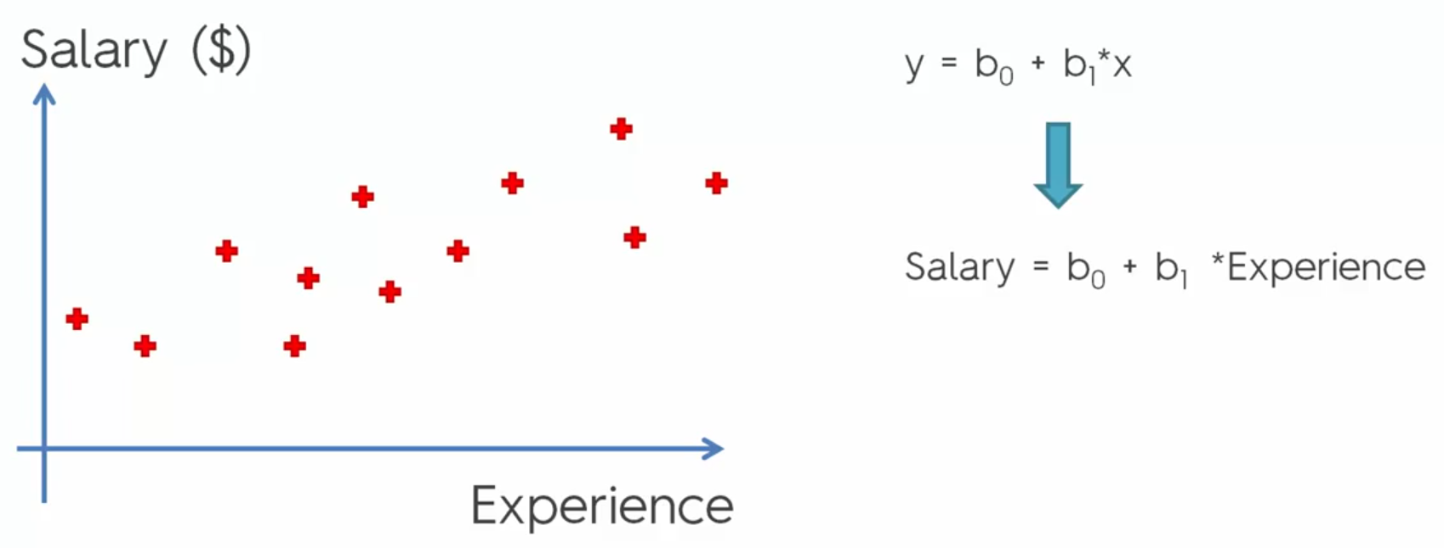
Simple Linear Regression
Salary and Experience

Slide 8
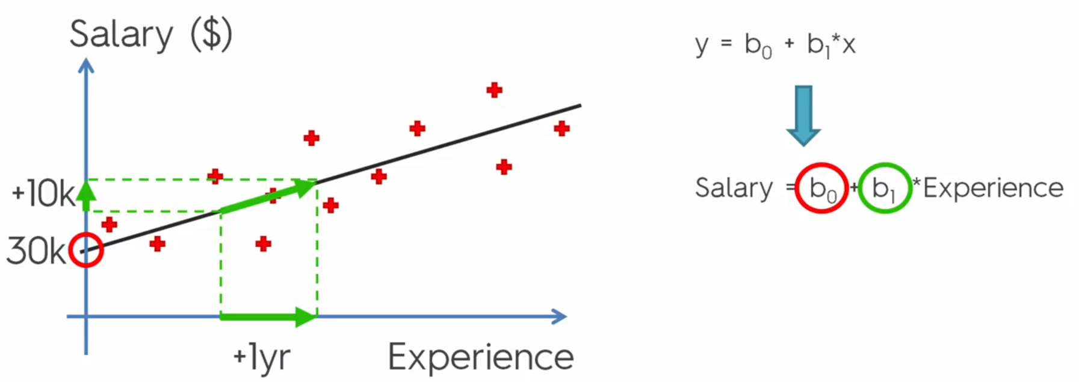
Simple Linear Regression – Continue
Linear Algebra
Notes:
B0 is Bias, B1 is the slop of the line

Slide 9
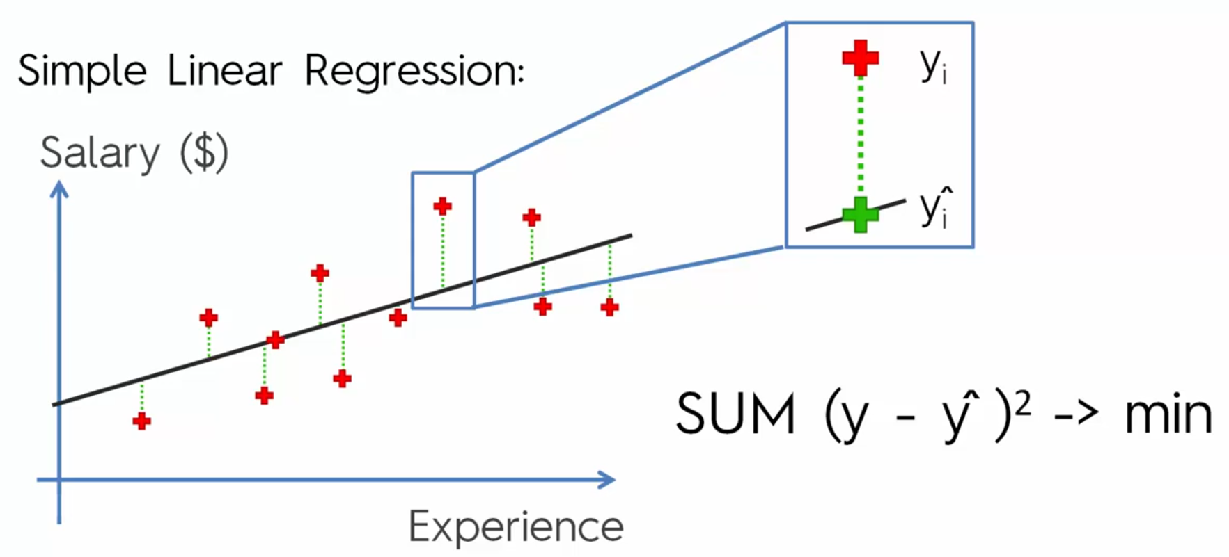
Ordinary Least Squares
Evaluation Models

Slide 10
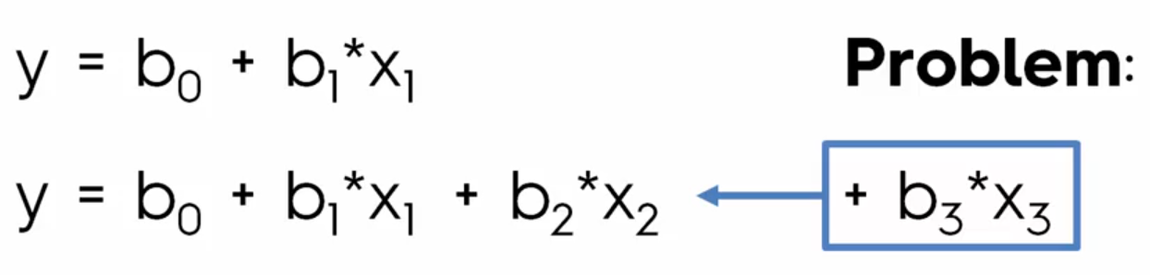
Adding Variable to reduce the ERROR rate
How many variable need to be added?

Slide 11
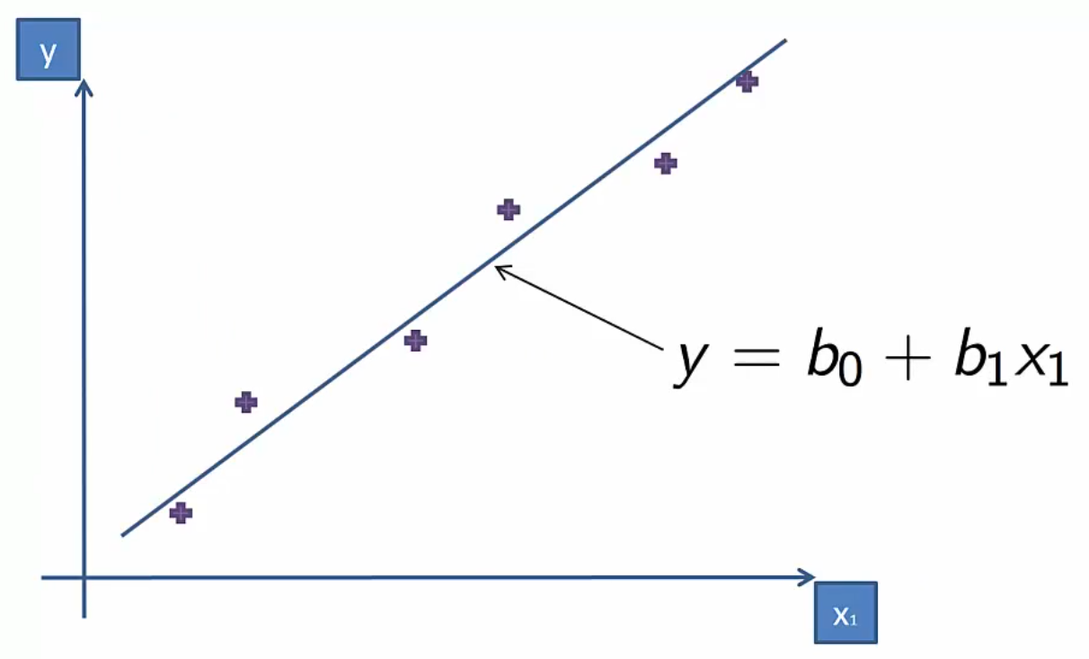
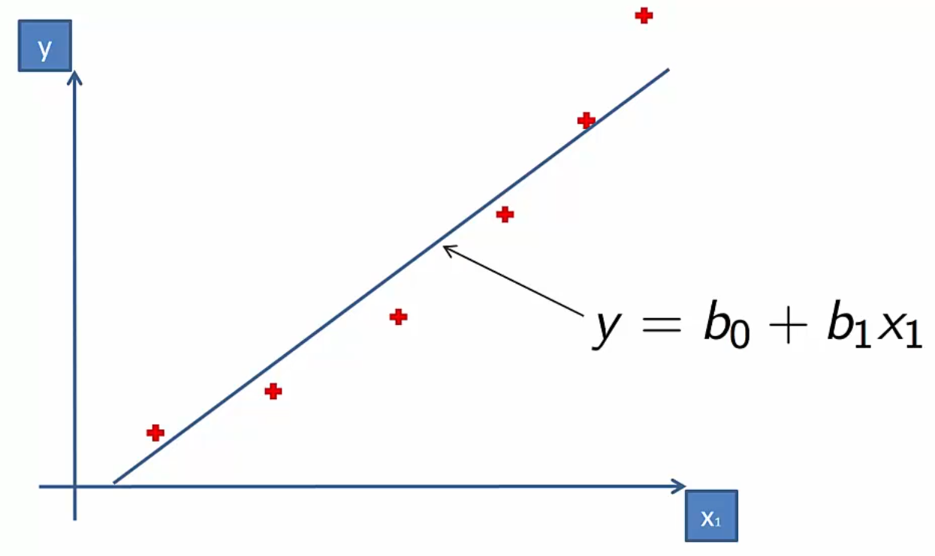
Notes:
Left fits well <> right does not fits well

Slide 12
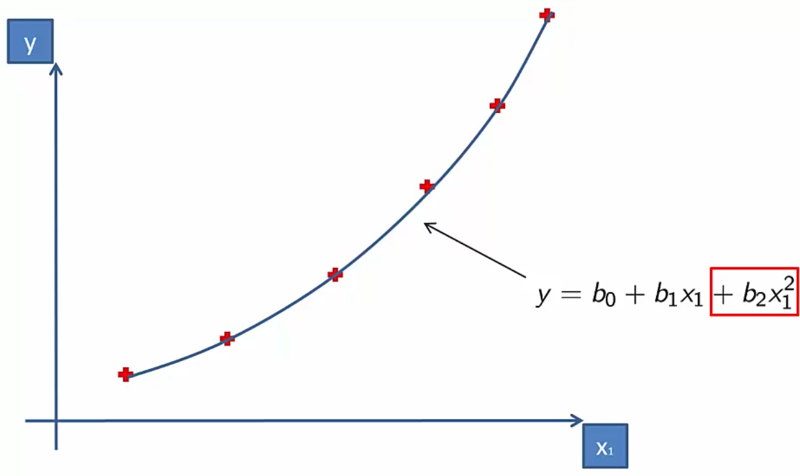
Why is called Linear?
Notes:
Coefficients are Linear!!

Slide 13
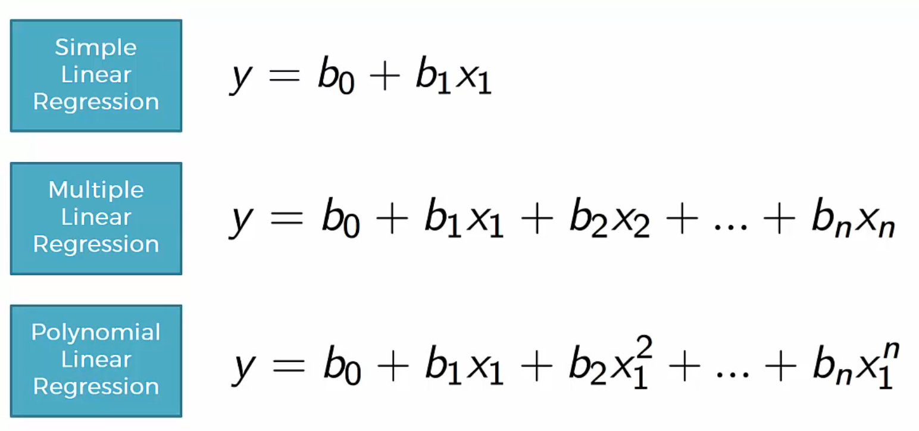
Single and Multi Variable vs Polynomial Linear Regression

Slide 14
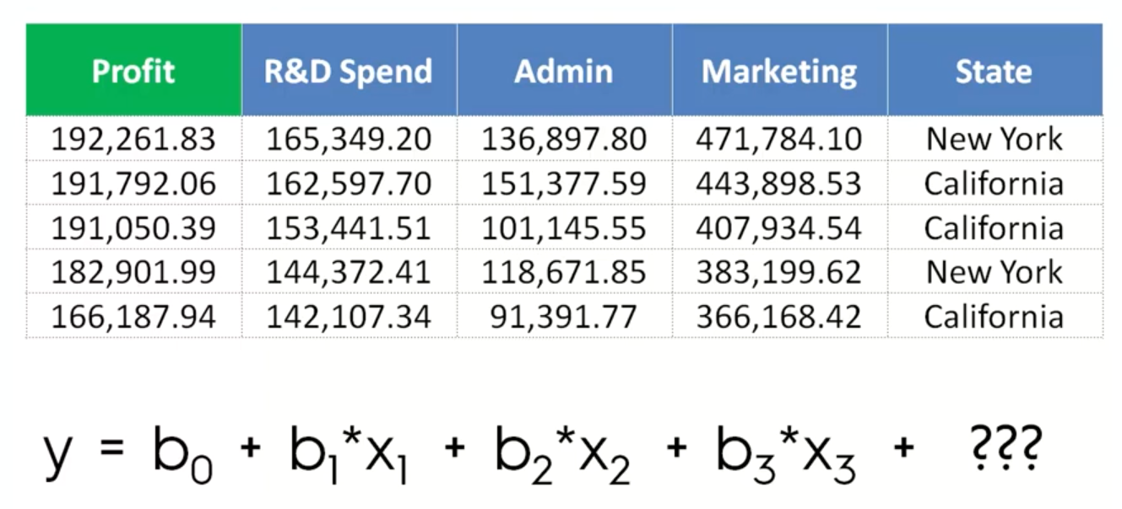

Slide 15
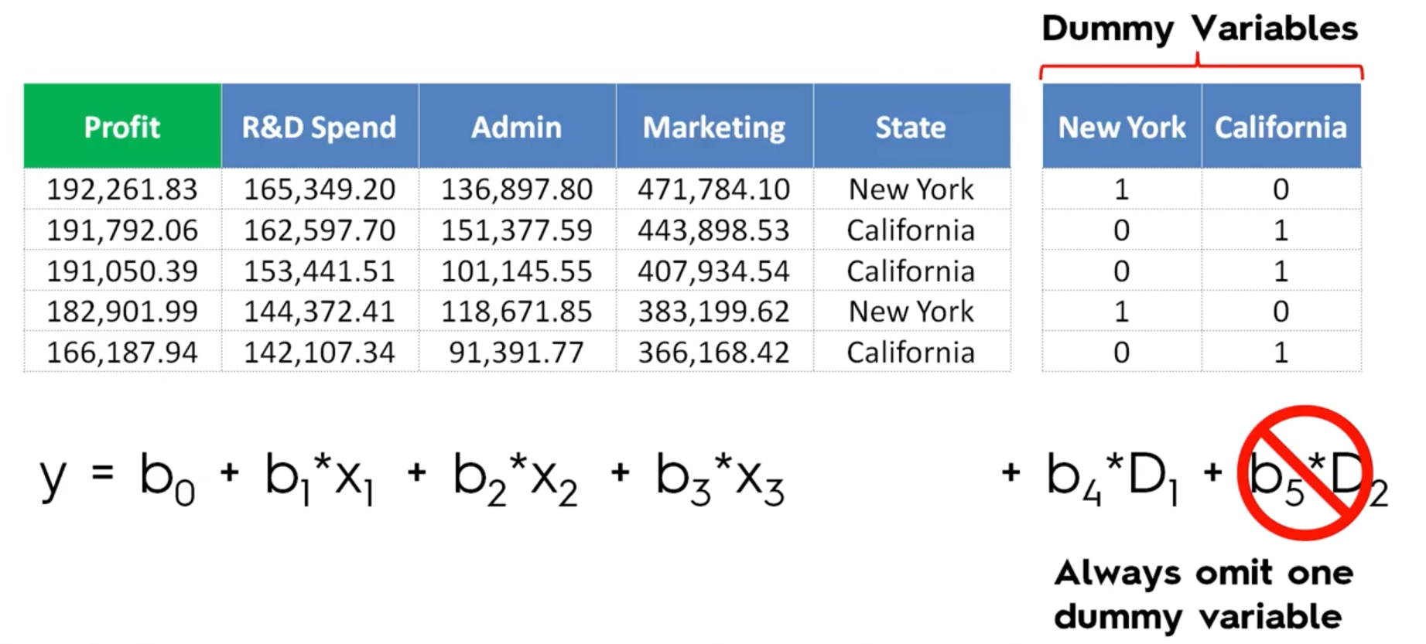
D1=1-D2 Multi-Colinearity

Slide 16
SVM – Support Vector Machine
Notes:
Non linear but continues model

Slide 18
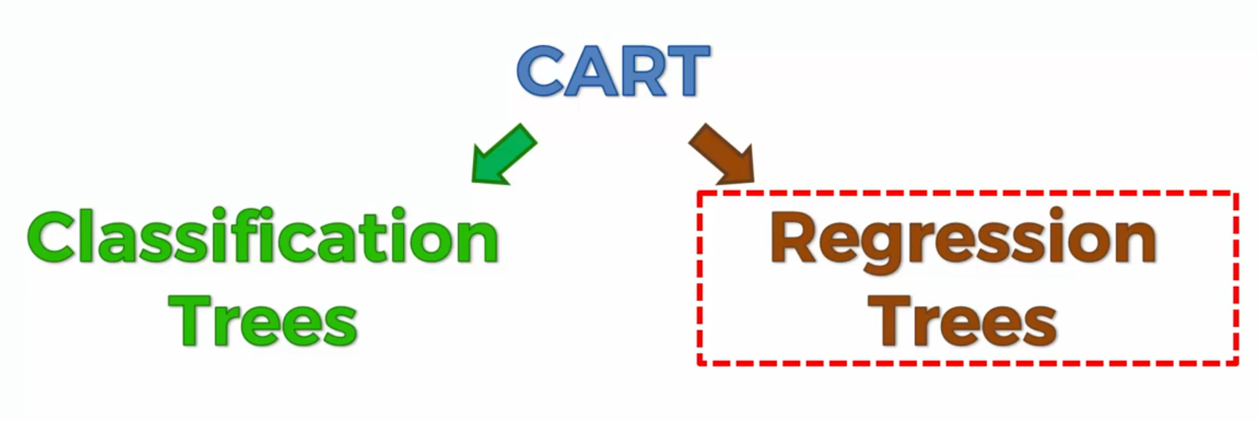
Classification and Regression Trees

Slide 19
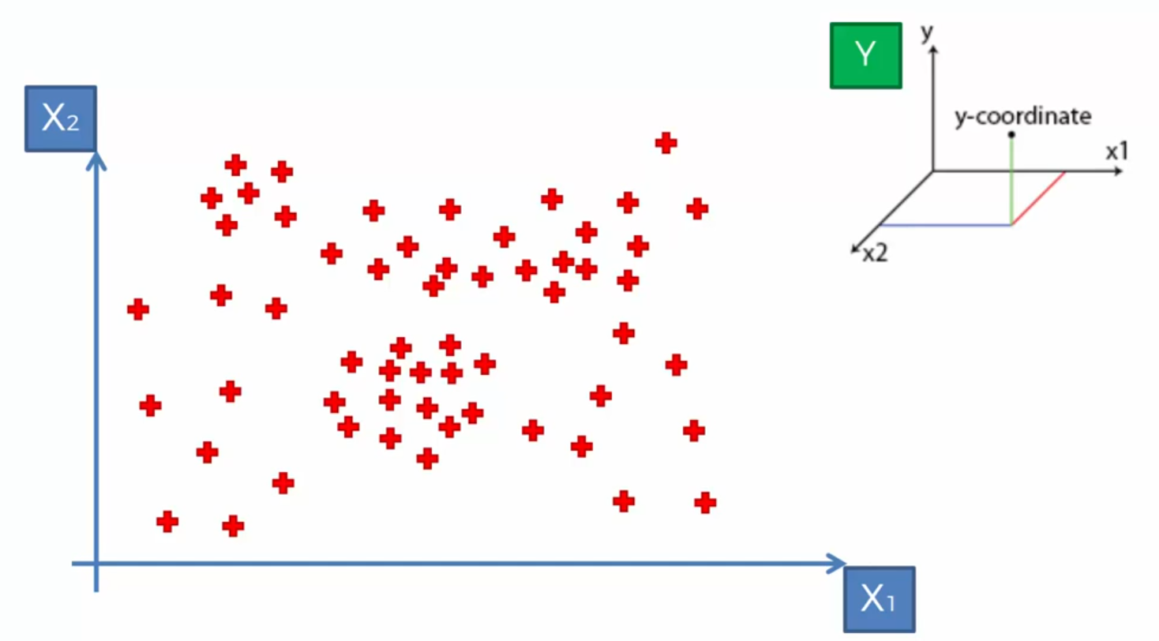
Decision Tree Intuition

Slide 20
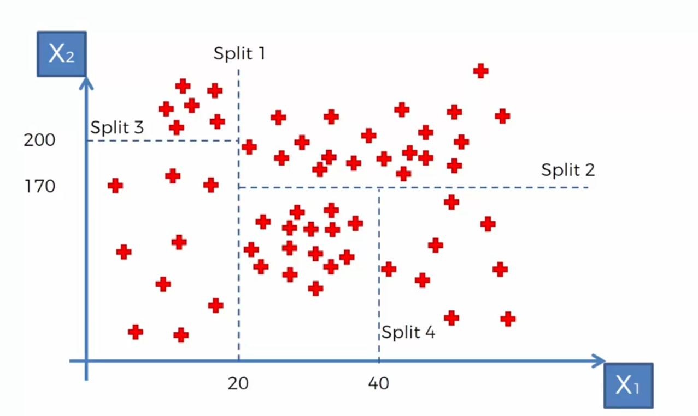
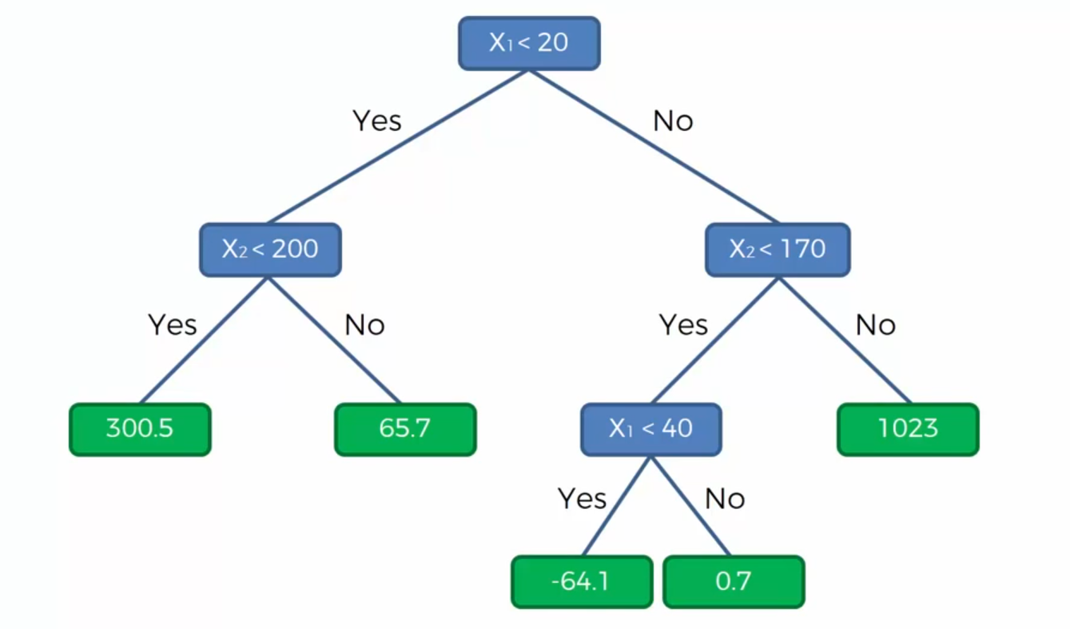
Notes:
Information Entropy… whether adding new split give us more info or not?

Slide 21
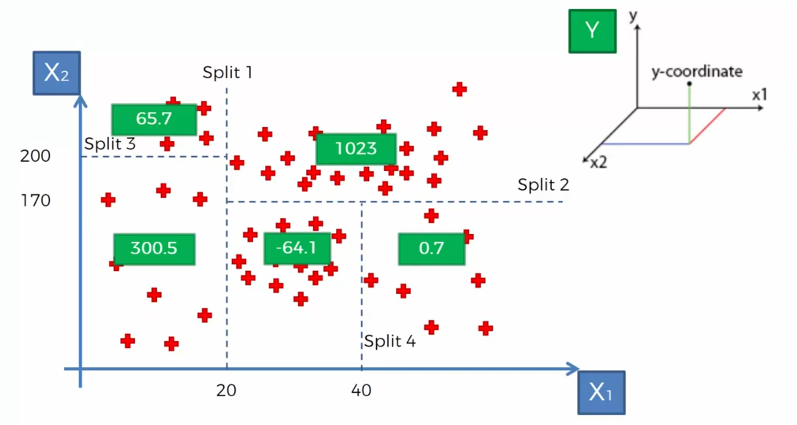
Decision Tree value for Regression models
Notes:
Non linear and not continues model

Slide 22
Decision Tree and Final output for Regression model
Notes:
Average of each partition will be the result of partition

Slide 23
Ensemble Learning
Bagging
Different independent sample
Random Forest
and for each sample you make a separate Decision Tree
Boosting
Weak learning
…

Slide 24
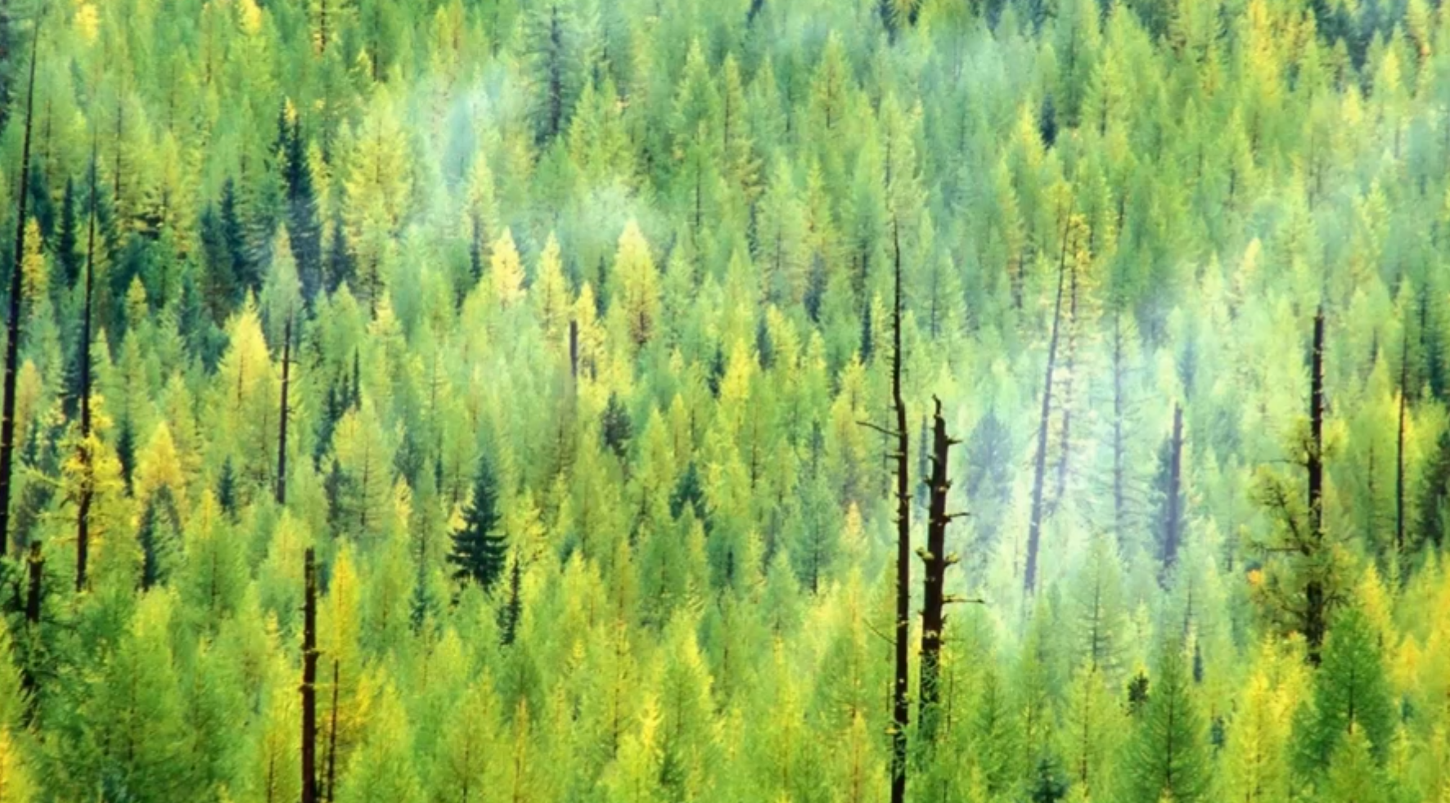

Slide 25
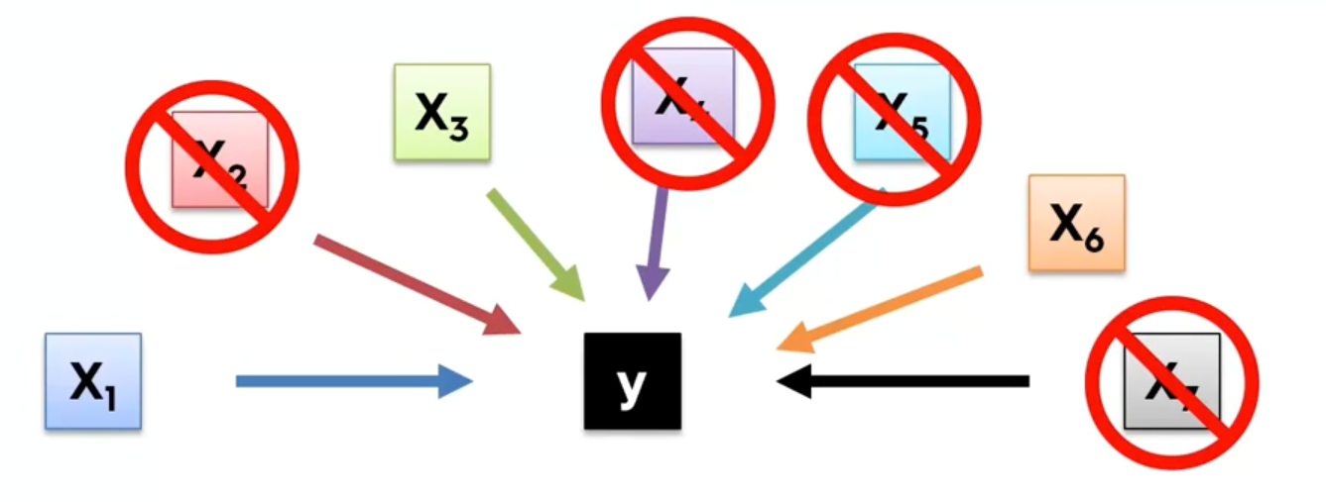
Building a Model
Why we don’t need to keep all columns?

Slide 26
Feature Scaling

Slide 27

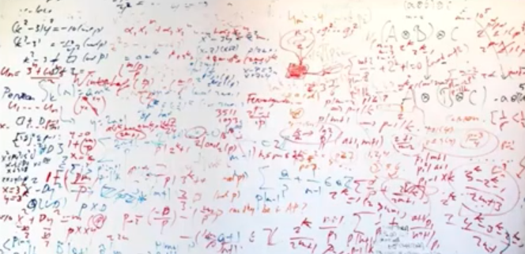
Building a Model
Why we don’t need all the Features?
Garbage in Garbage out
Complexity and confusion

Slide 28
Objectives and Overview
Predict the burned area of forest fires!
A reusable end-to-end Regression framework
EDA
Feature Selection
Feature Engineering
Training and Test Data selection
Modeling
Pipeline for each possible steps
Hyper Parameter Tuning
Evaluation

Slide 29
Classification

Slide 30
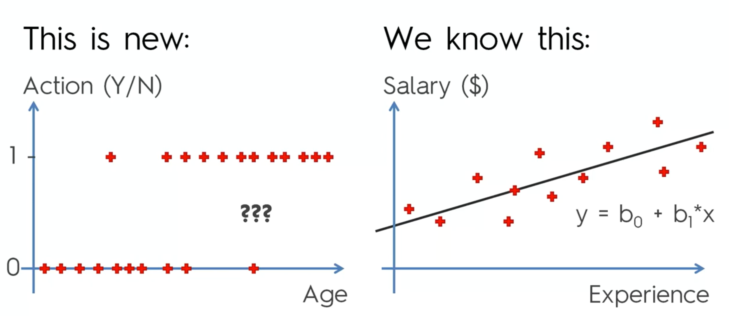
Classification

Slide 31
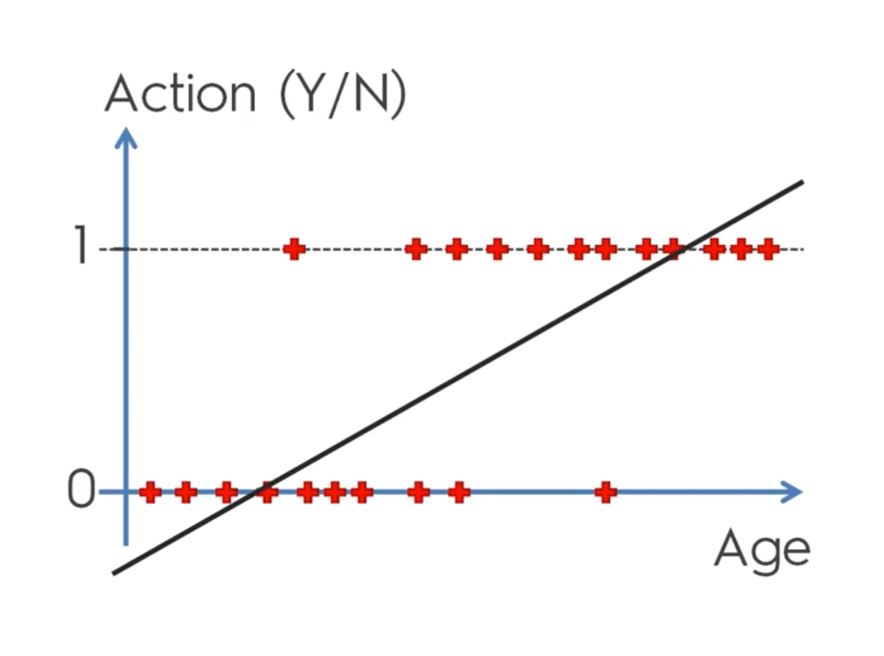

Slide 32
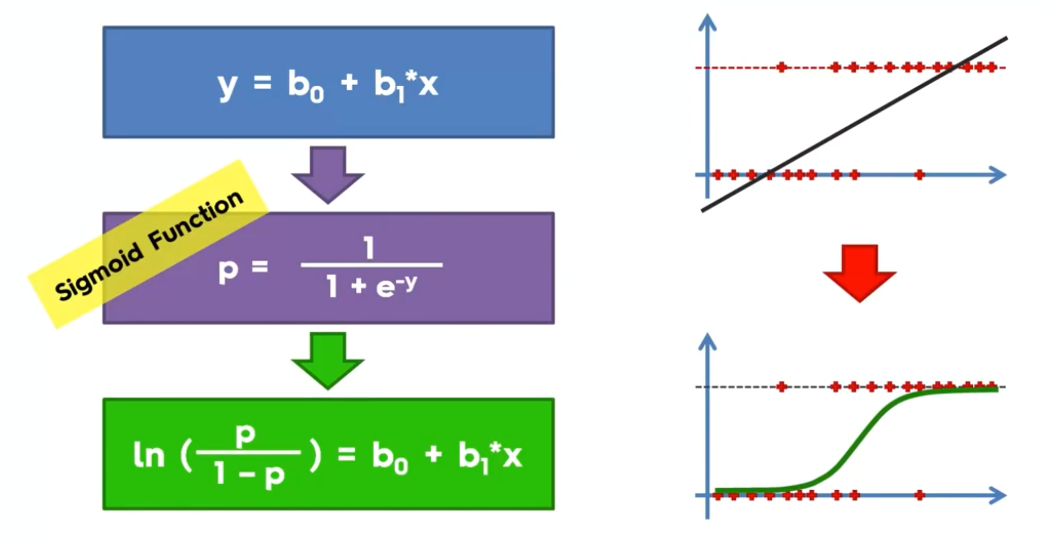
Notes:
Forget this for learning

Slide 33
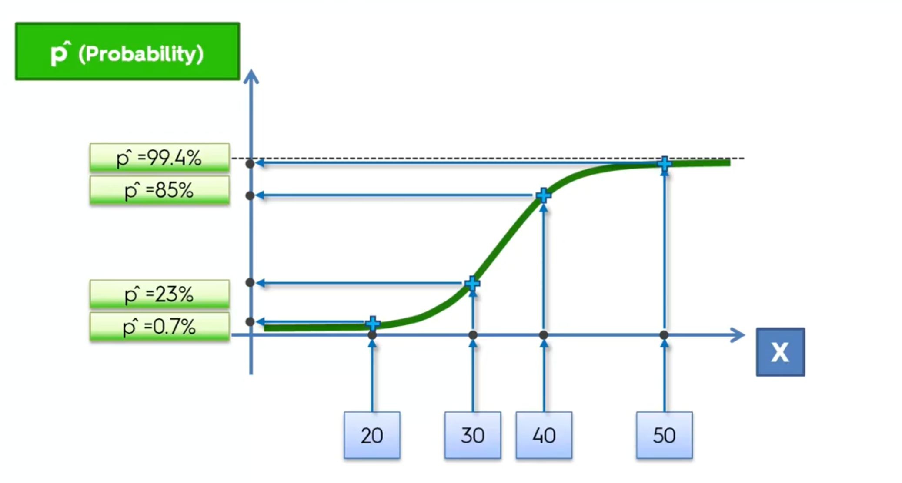

Slide 34
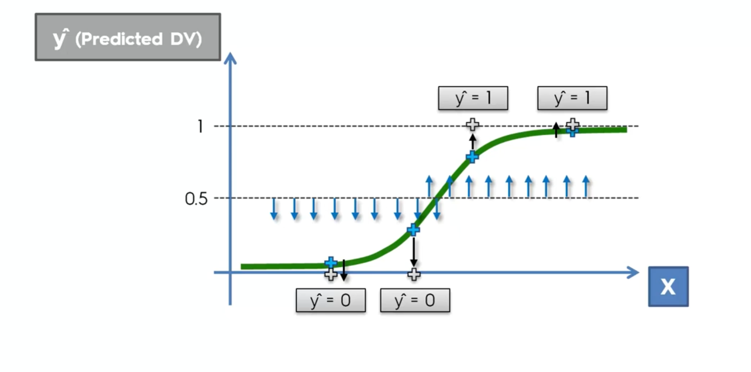

Slide 35
K-Nearest Neighbor
Choose the number K of neighbors
Take the K nearest neighbors of the new data point, according to the Euclidean distance
Among these K neighbors, count the number of data points in each category
Assign the new data pint to the category where you counted the most neighbors
Your Model is ready
Notes:
Default is 5

Slide 36
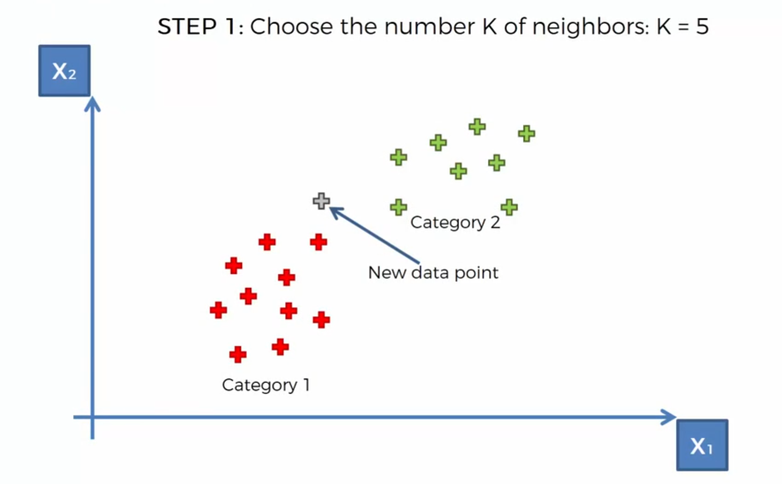
K-NN

Slide 37
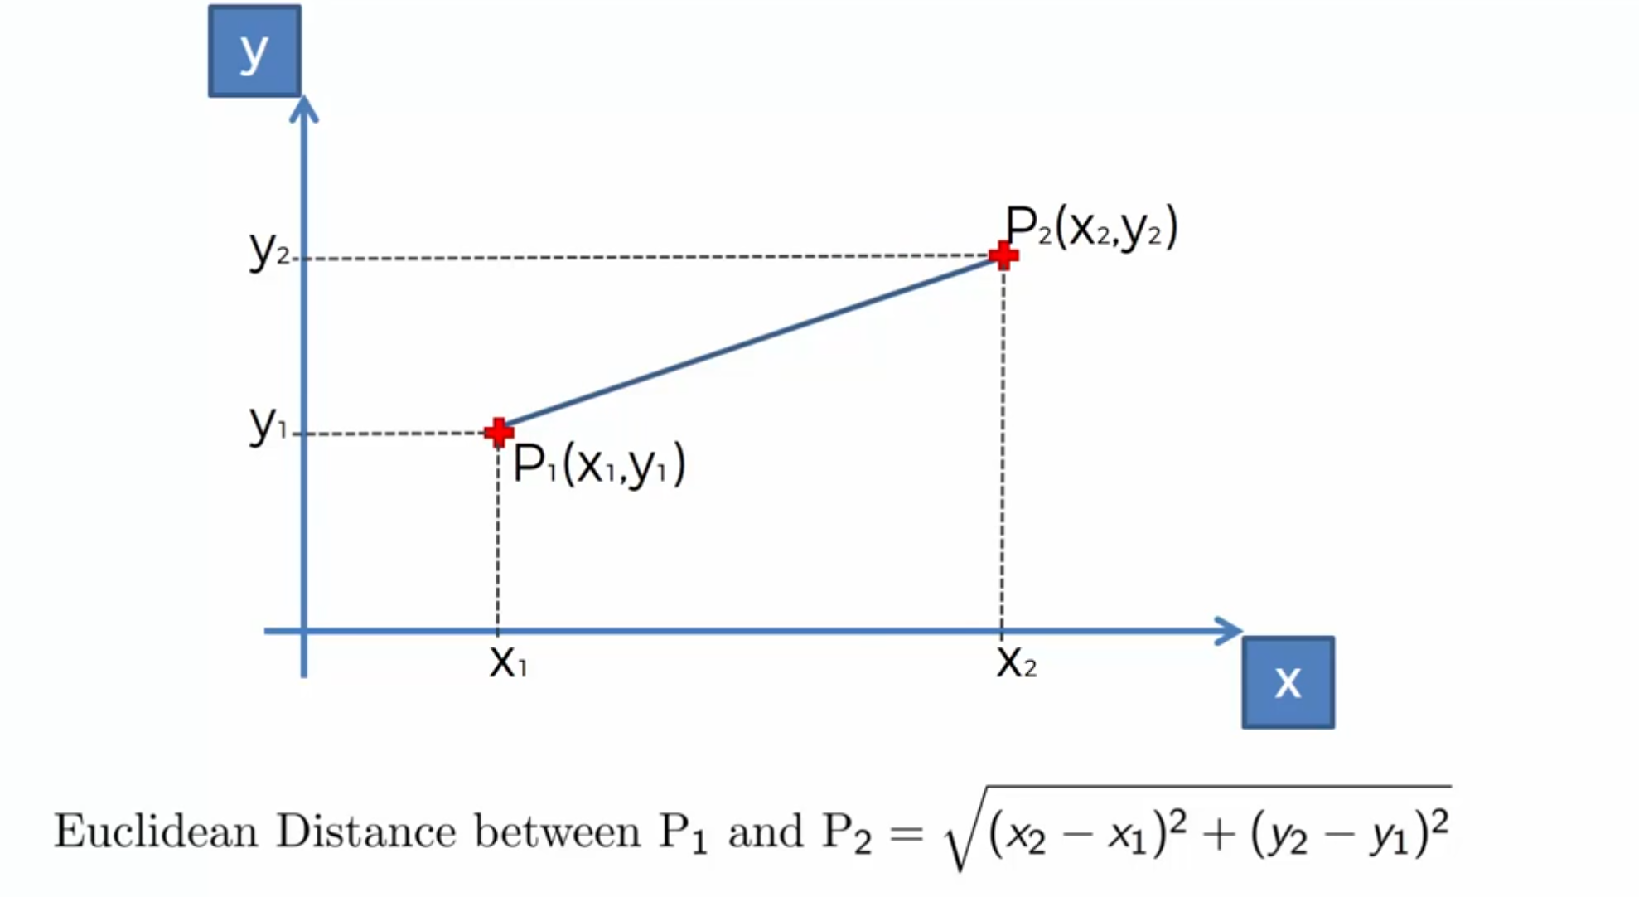

Slide 38
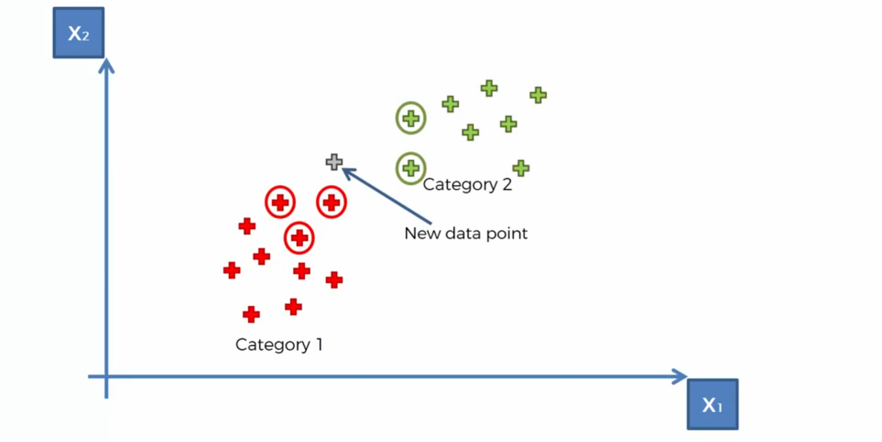
K-NN

Slide 39
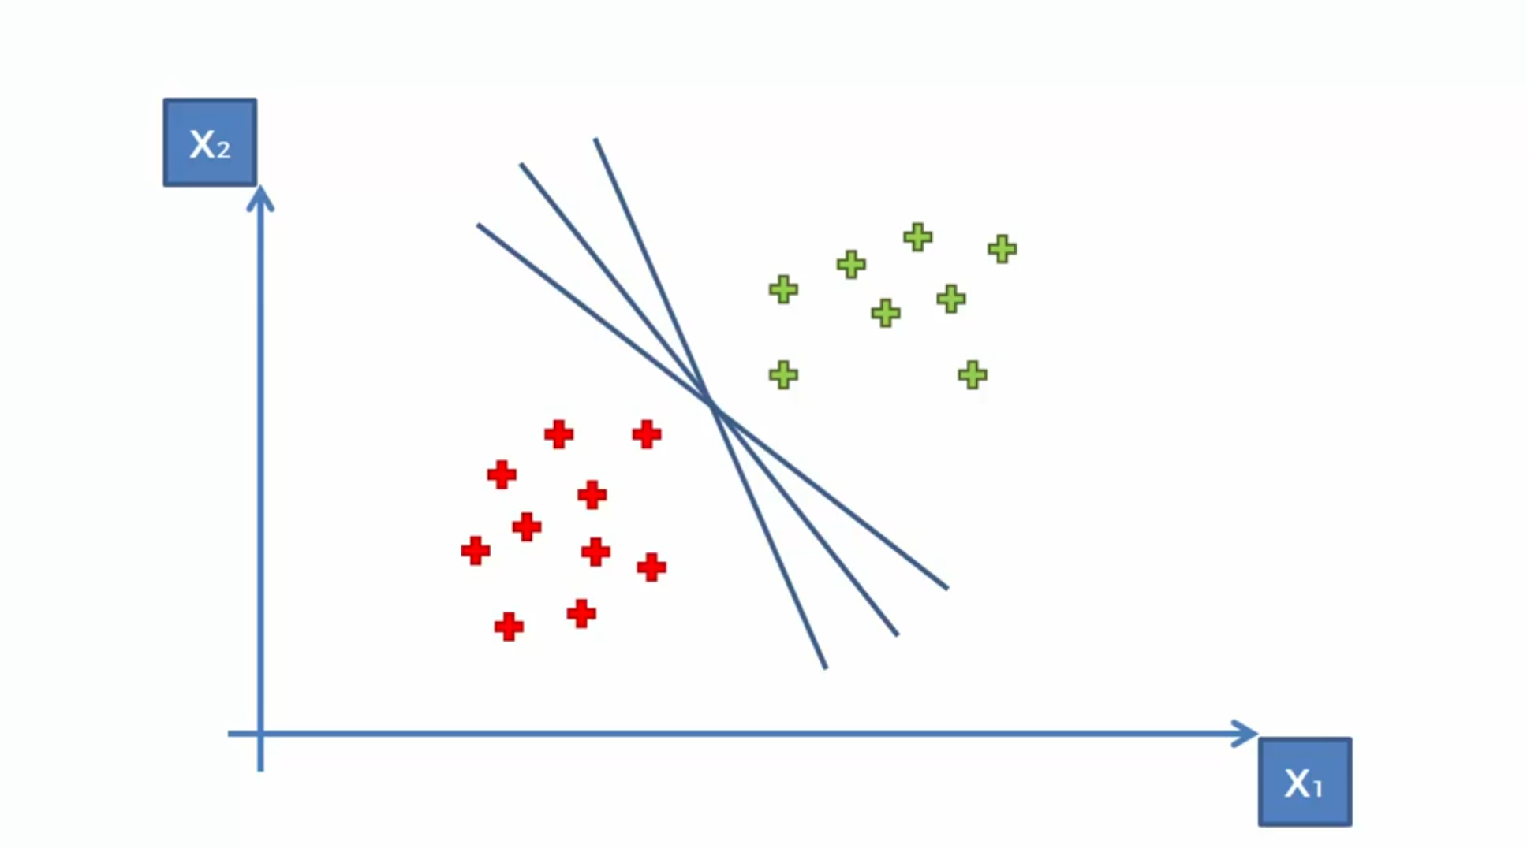
Support Vector Machine (SVM)

Slide 40
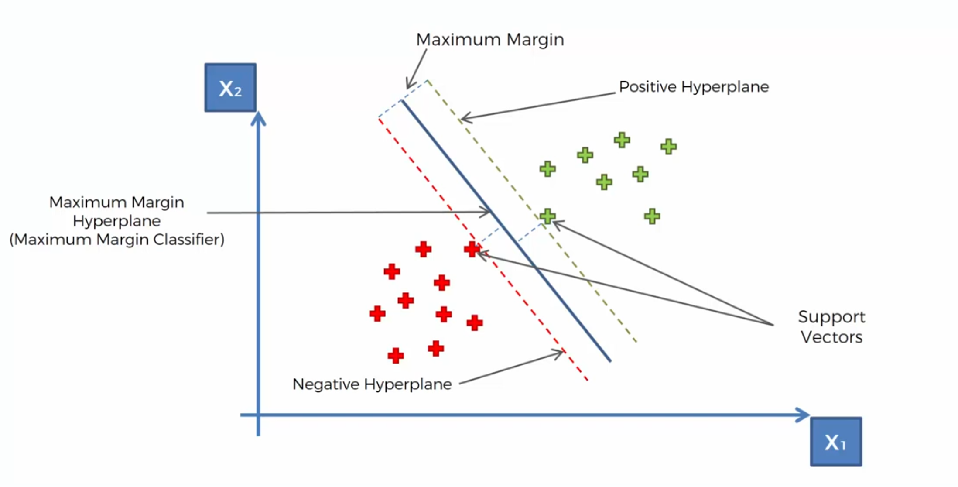
SVM

Slide 41

SVM

Slide 42
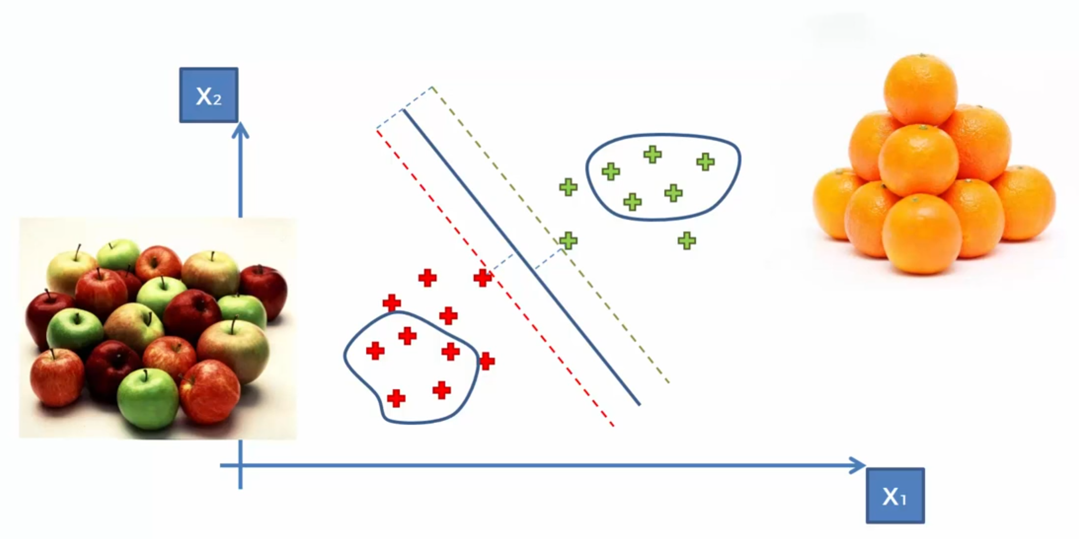
Most of the other ML models

Slide 43
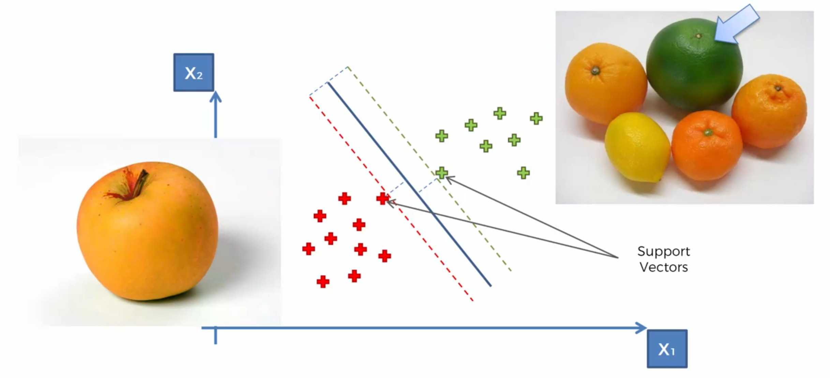
What is so special about SVMs?

Slide 44
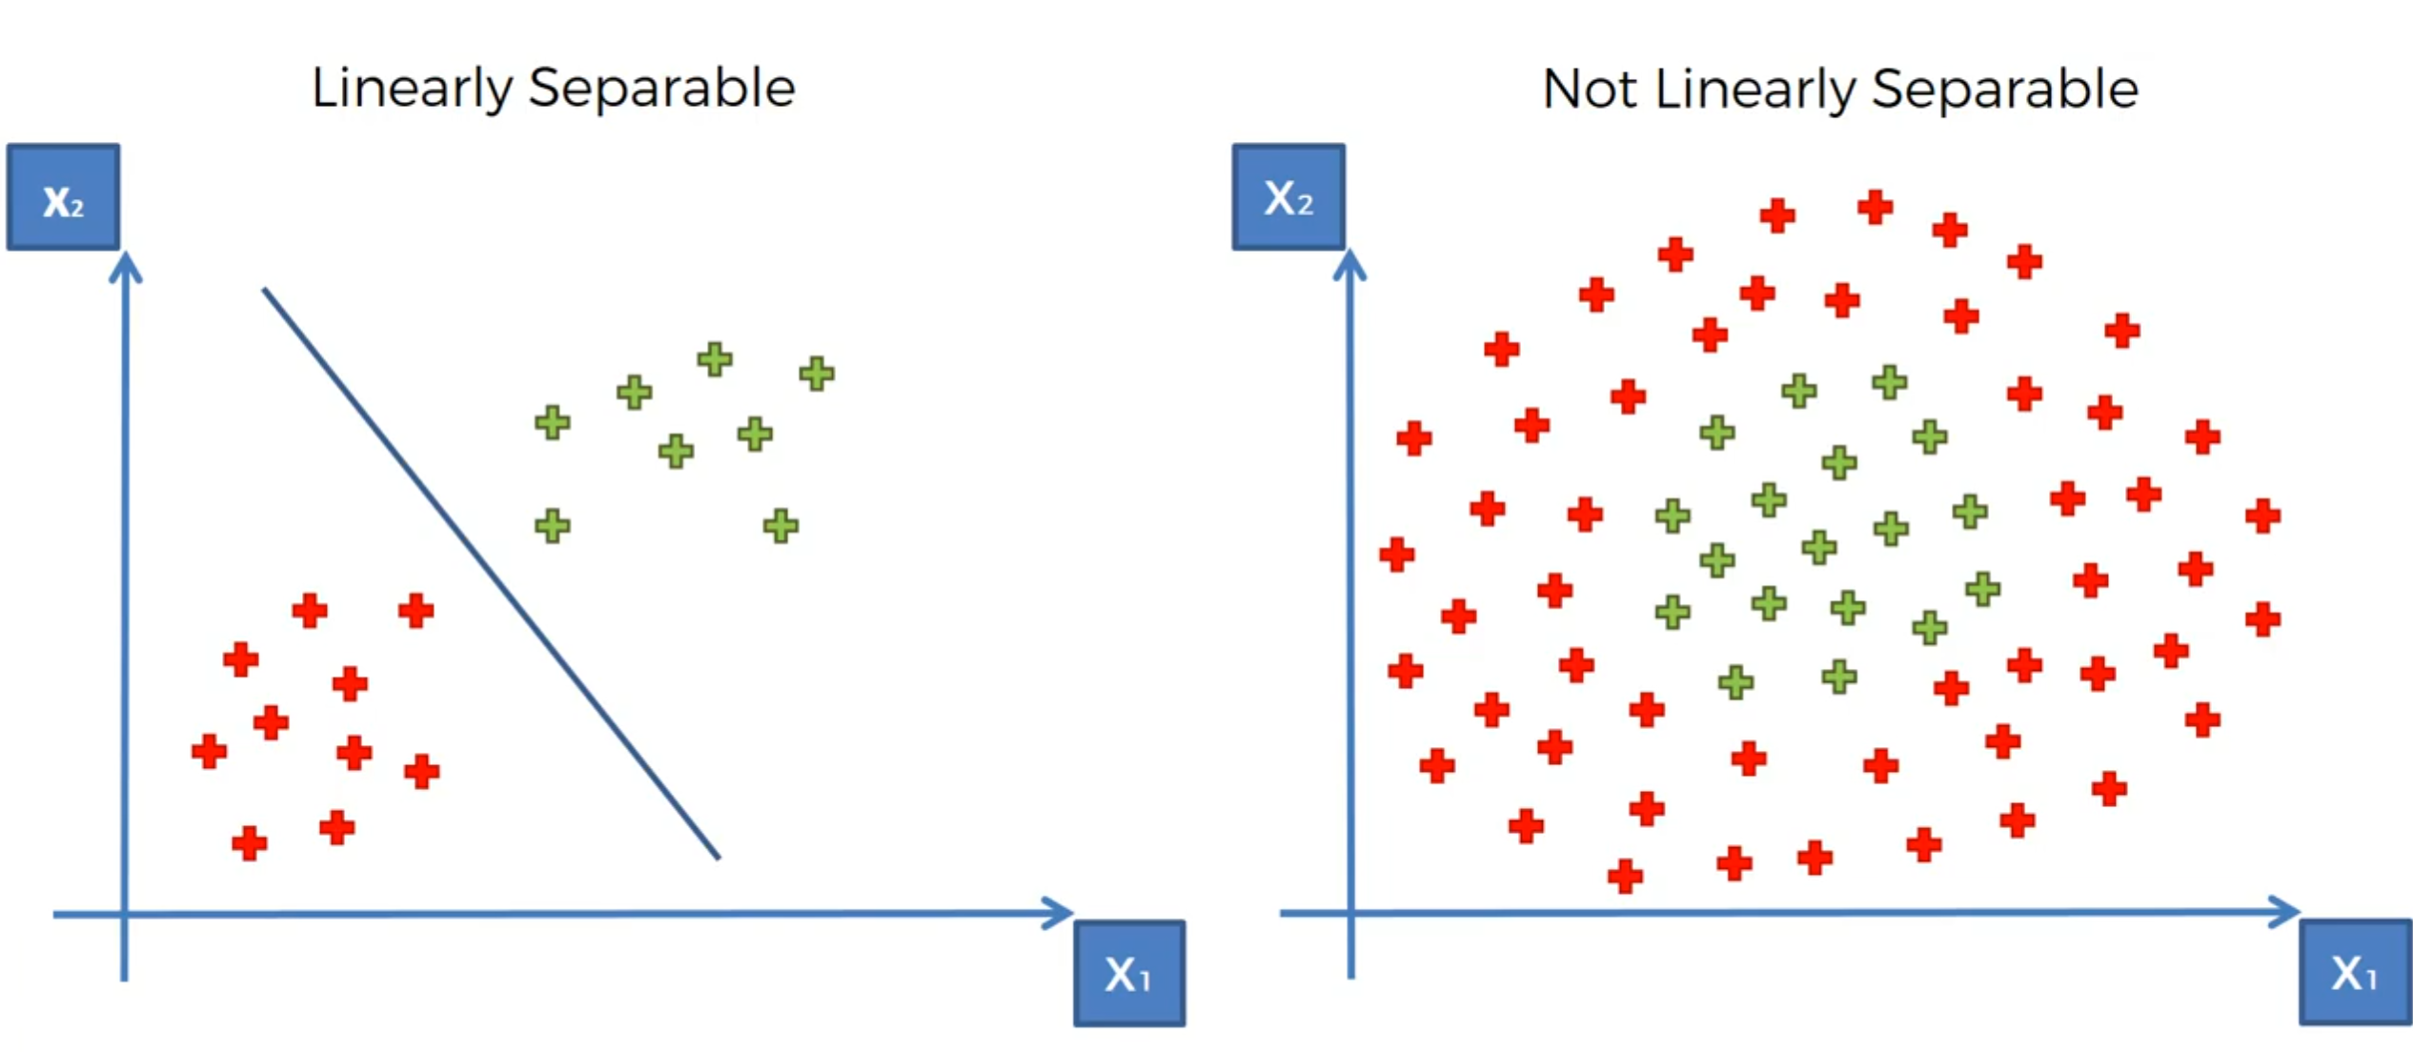
Linear Separability

Slide 45
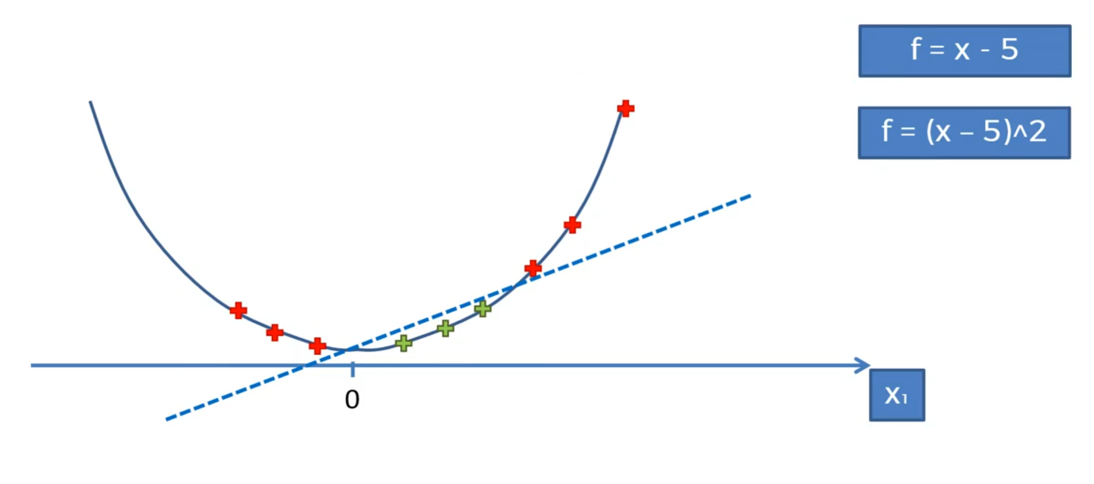
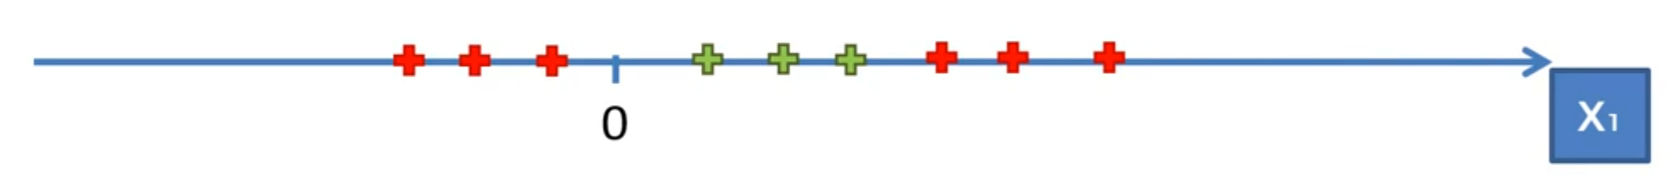
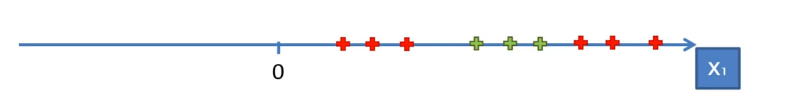
Mapping to Higher Dimension

Slide 46
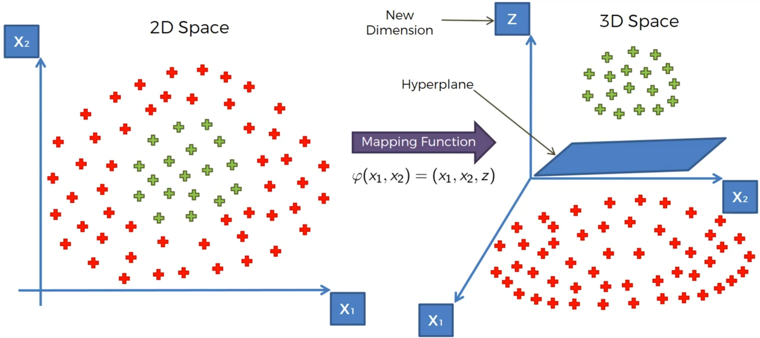
Mapping to Higher Dimension

Slide 47
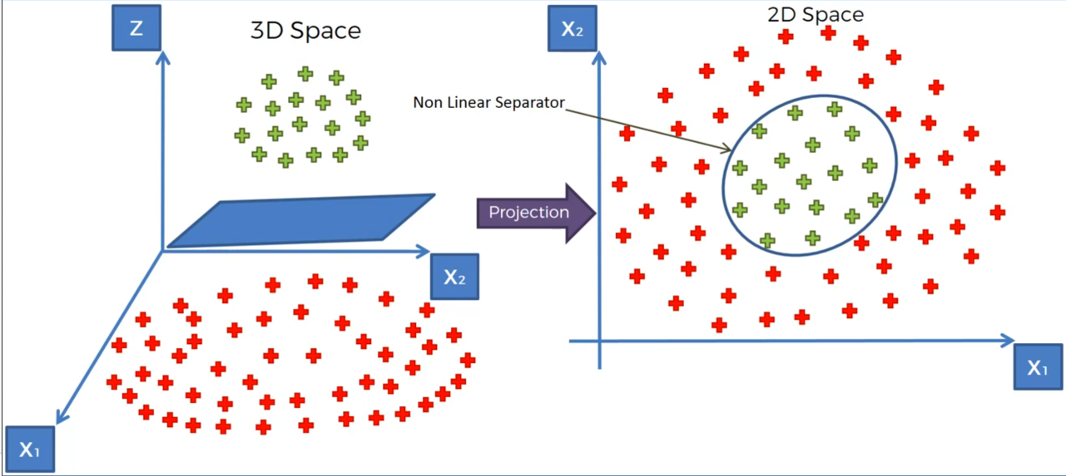
Projecting back to 2D space
Notes:
Bringing to Higher Dimension may need huge processing

Slide 48
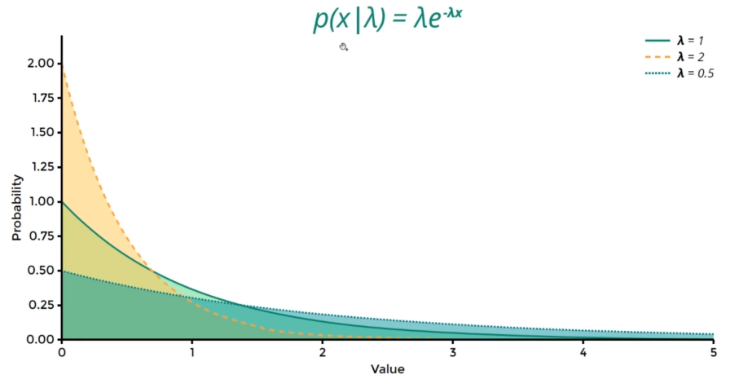
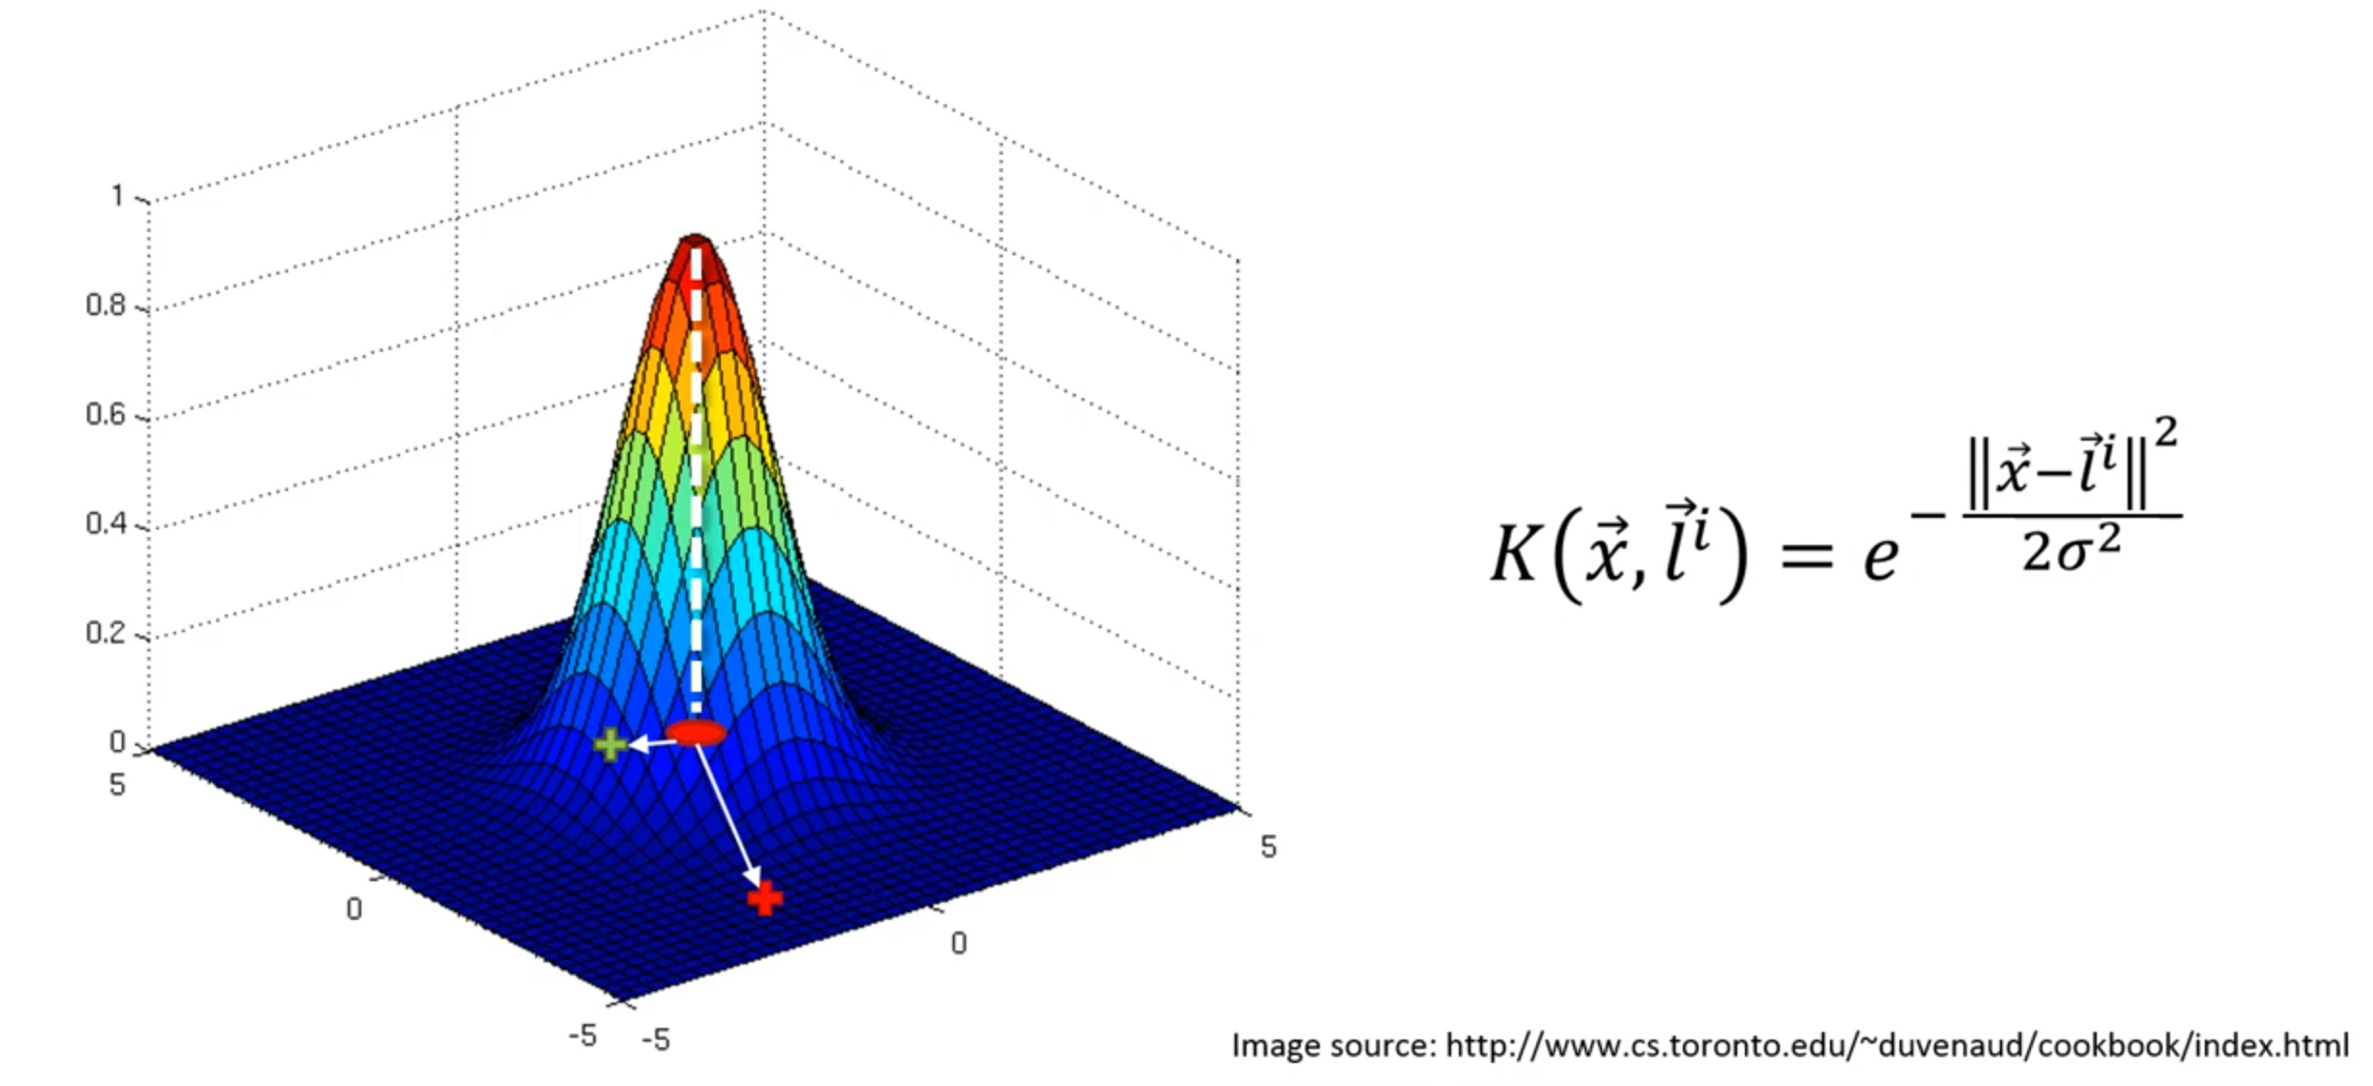
The Kernel Trick
The Gaussian RBF Kernel
Notes:
L is landmark in the above formula, RBF stands for Radial Basis Function Kernel

Slide 49
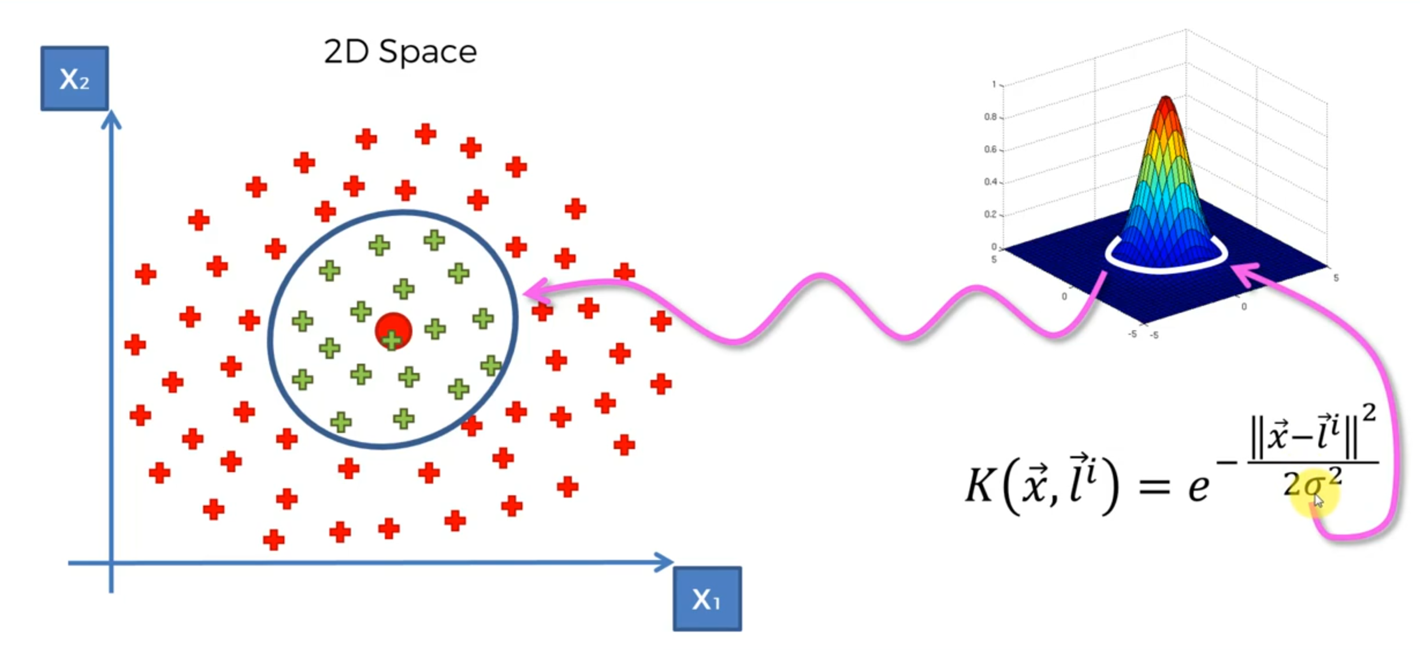
The Gaussian RBF Kernel

Slide 50
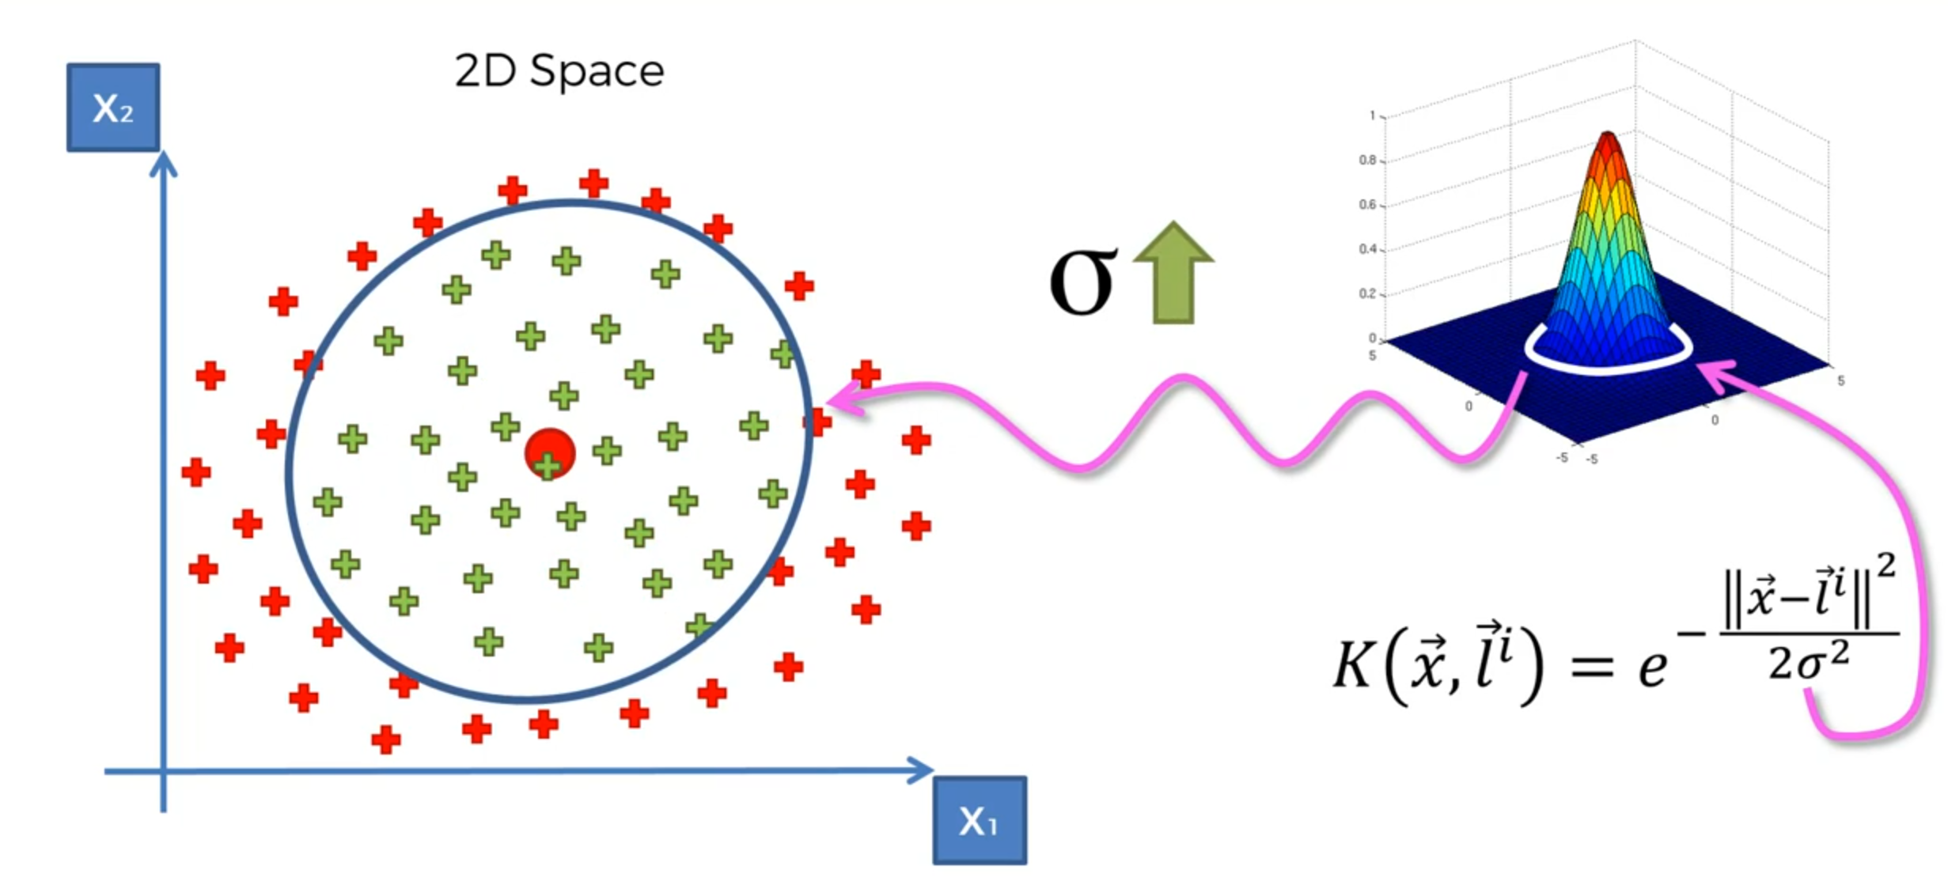
Increase the Sigma in Gaussian RBF Kernel

Slide 51
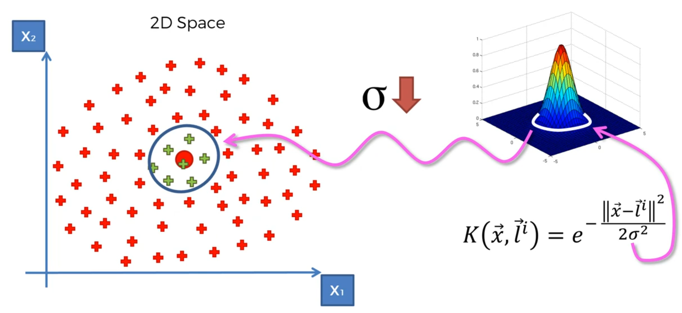
Decrease the Sigma in Gaussian RBF Kernel

Slide 52
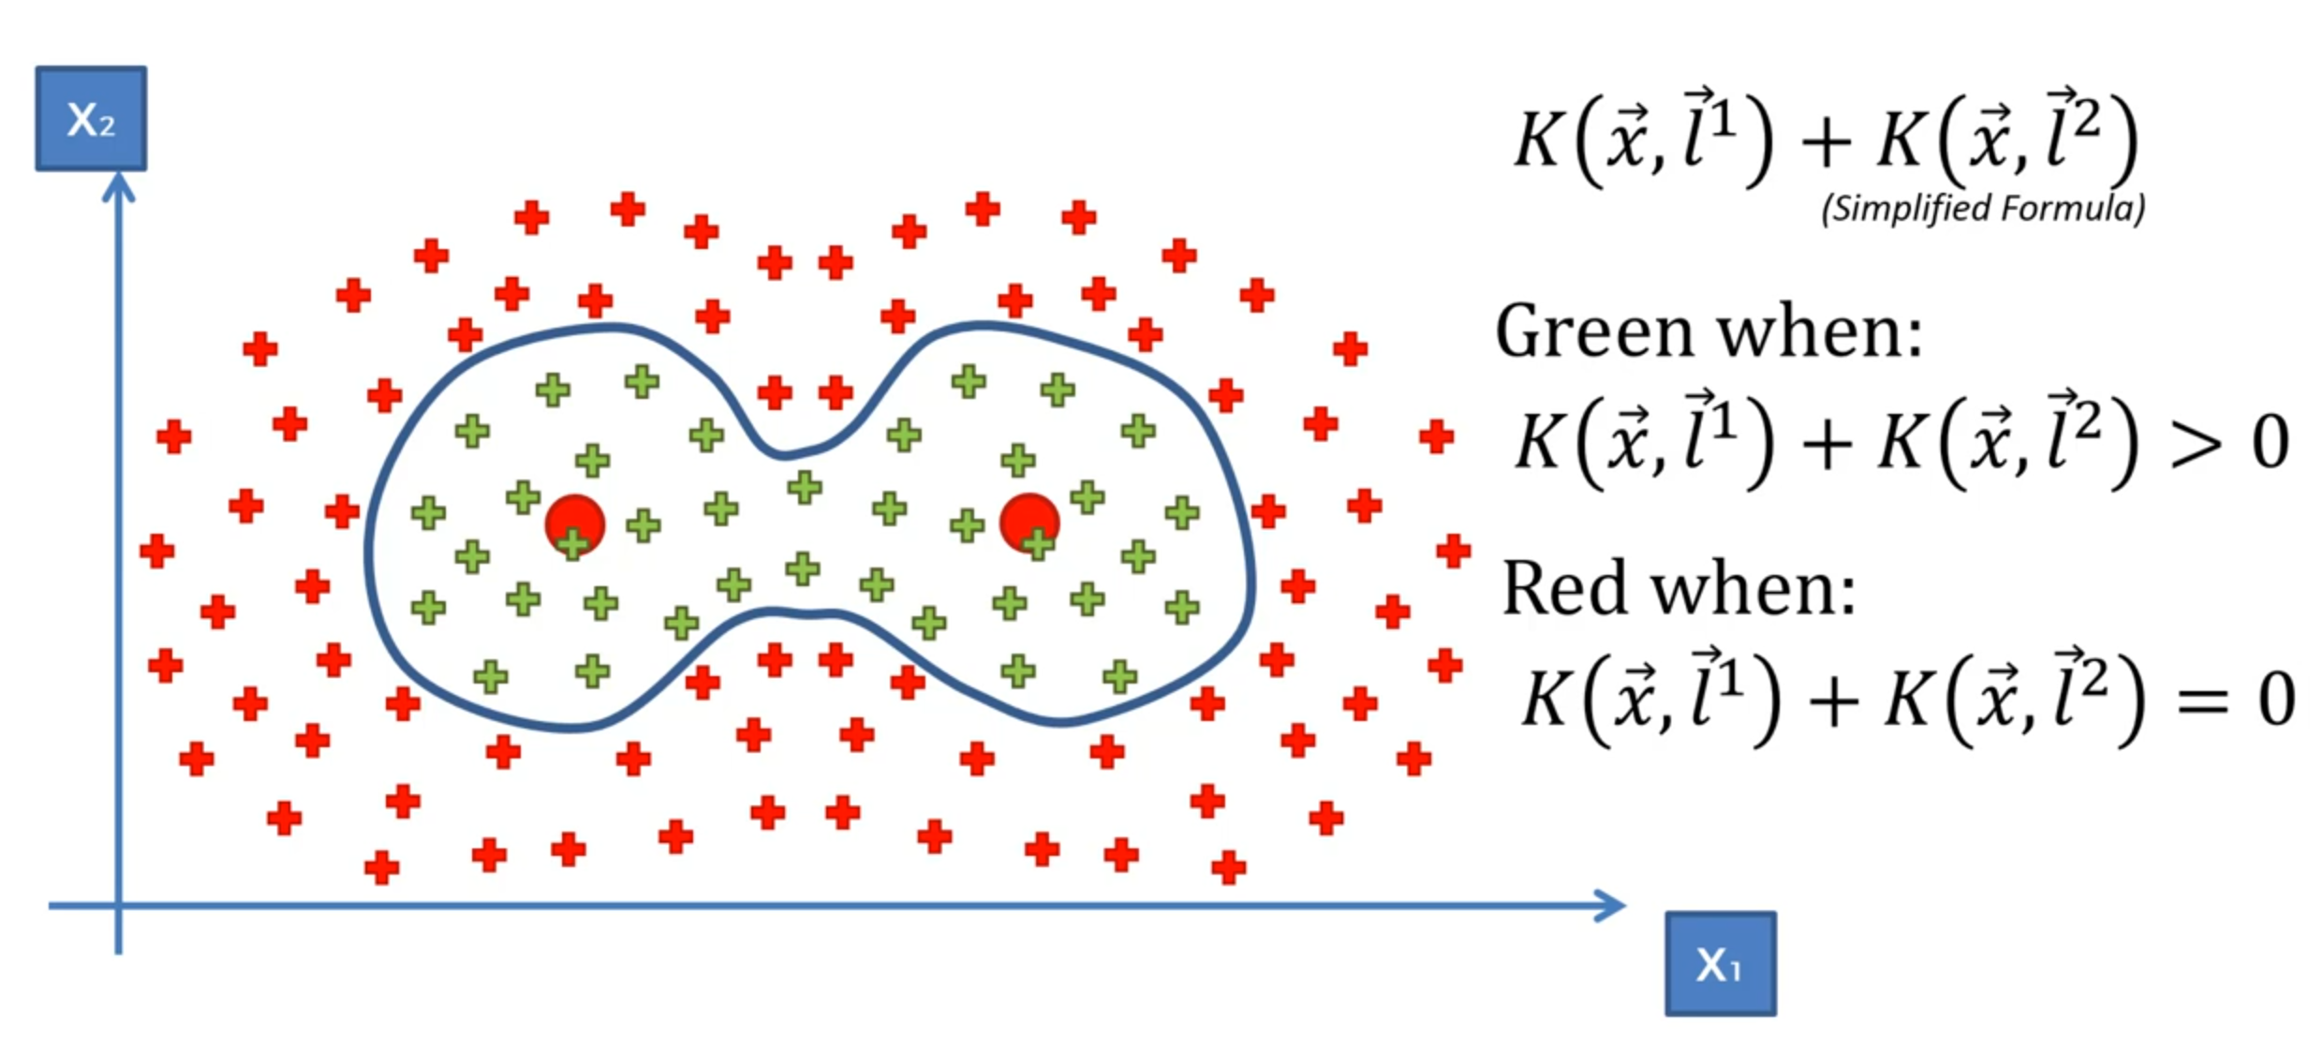
More Complex Gaussian RBF Kernel

Slide 53
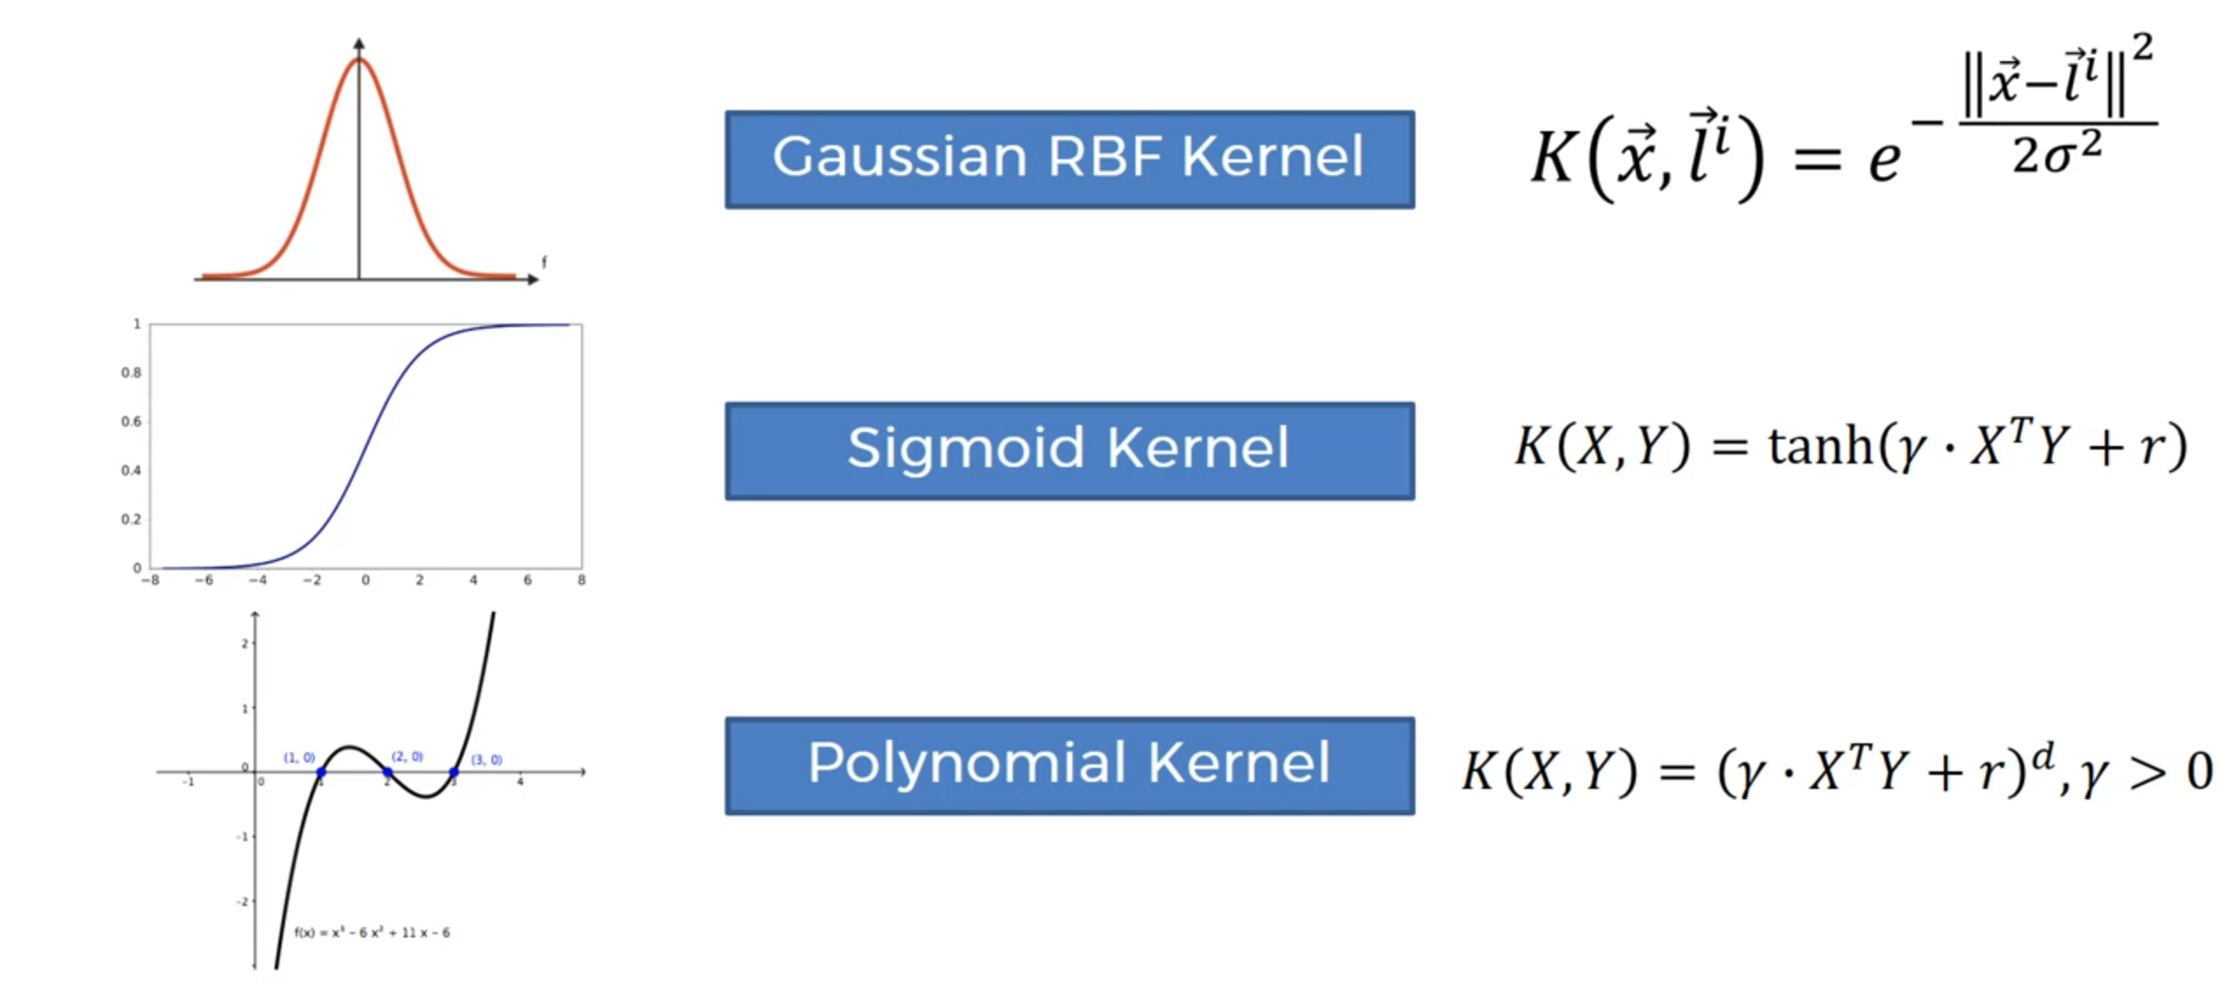
Different Type of Kernel Function

Slide 54
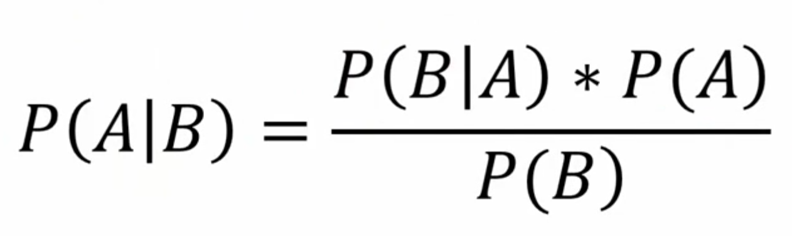
Naïve Bayes
For each data point, what is the probability to be in each class, then we select the one which is bigger!
Notes:
W

Slide 55
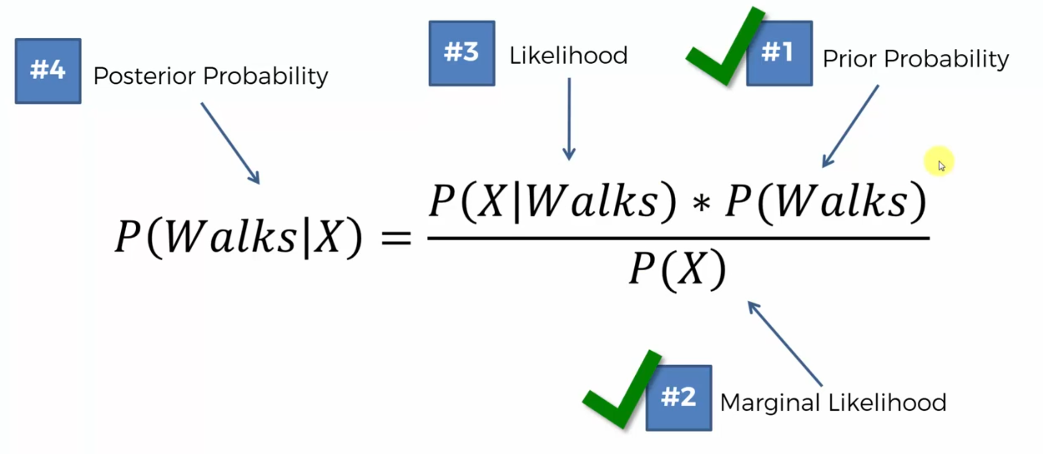

Slide 56
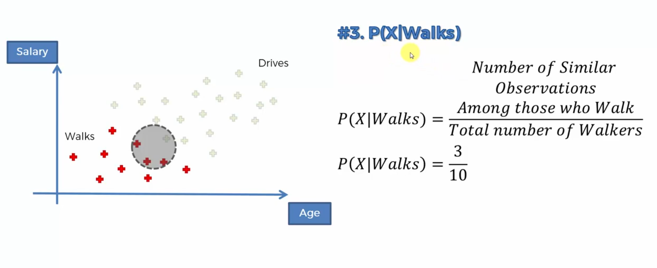
Naïve base

Slide 57
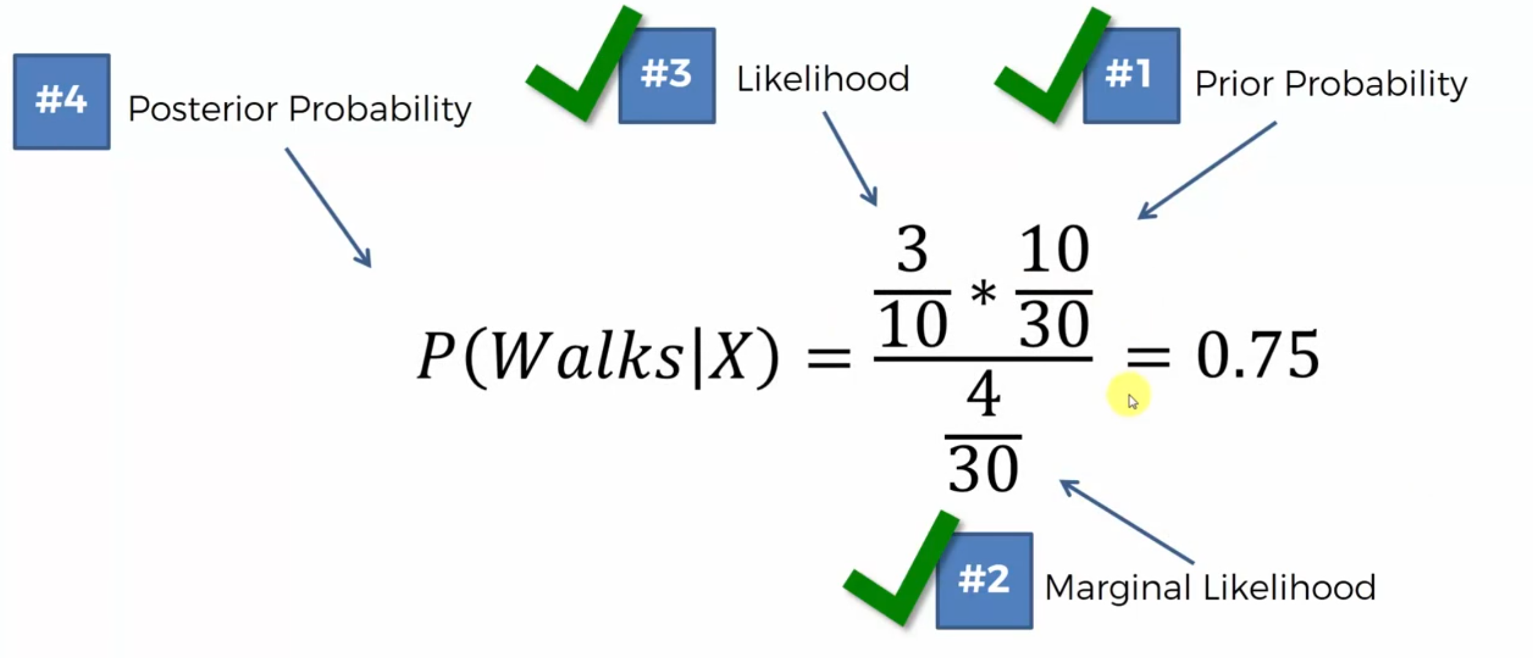

Slide 58


Slide 59


Slide 60



Slide 61
Evaluation Models
https://towardsdatascience.com/various-ways-to-evaluate-a-machine-learning-models-performance-230449055f15
Regression
MSE
RMSE
Classification
Confusion Metrix
Accuracy
Precision
Recall
F1 Score
ROC_AUC

Slide 62

Evaluating Classification Models

Slide 63

Confusion Matrix

Slide 64

Why Accuracy is not enough?

Slide 65

Why Accuracy is not enough?

Slide 66


Cumulative Accuracy Profile
Notes:
Assumption for a given shop:
100K Customer
10% percent of the ad. random email will be a purchase

Slide 67

Cumulative Accuracy Profile

Slide 68


Model Rate!

Slide 69
K-MEANS Clustering Algorithm
Choose the number K of clusters
Select at random K points, the centroids (not necessarily from your dataset)
Assign each data point to the closest centroid-->> that forms K clusters
Compute and place the new centroid of each cluster
Reassign each data point to the new closest centroid.
If any reassignment took place, go to STEP 4, otherwise go to FIN.
YOUR MODEL IS READY

Slide 70










Slide 71


Thank You
Abbas Malekpour
Abbas.malekpour@gmail.com

